Slide 1
ShopBot Headquarters, Durham, NC

Slide 2
ShopBot’s reason for being

Slide 3
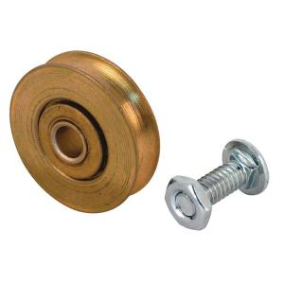
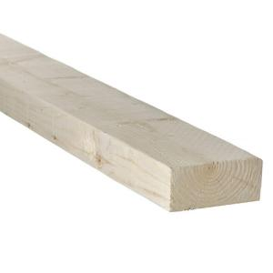
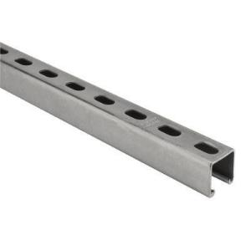

Slide 4
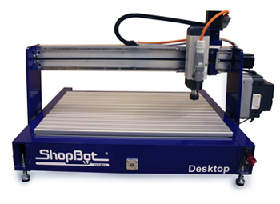
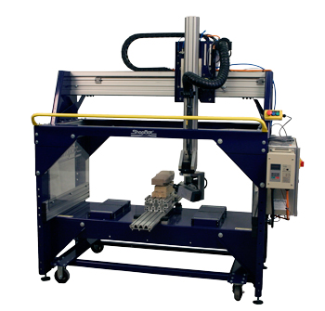
ShopBot DeskTop
5 Axis ShopBot

Slide 5
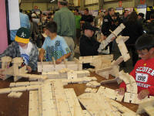
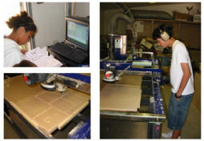
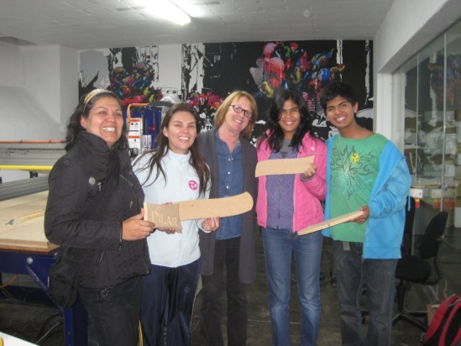
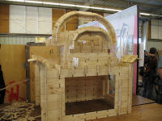
ShopBot in Education and Innovation
Schools
FabLabs
TechShops

Slide 6
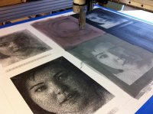
Artists Using ShopBots Drawing with Ink

Slide 7
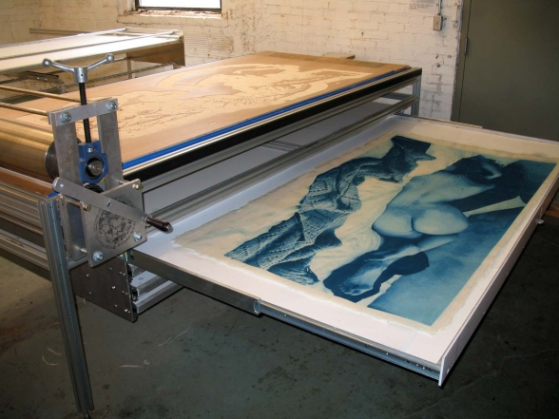
Plates for printing

Slide 8
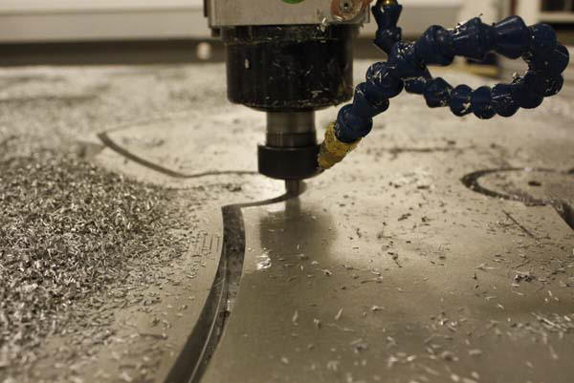
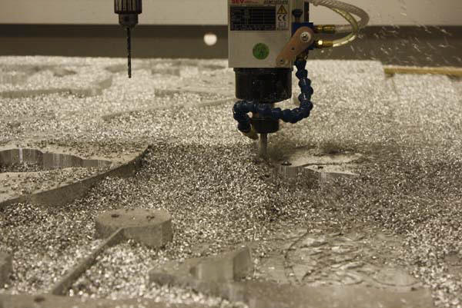
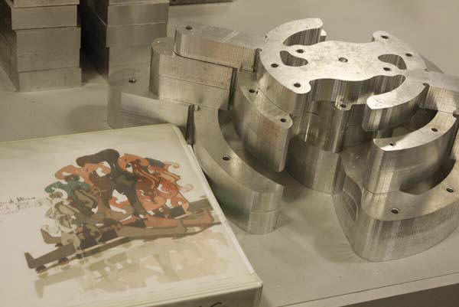
Machining Aluminum

Slide 9
Molds for Casting

Slide 10
3D carving

Slide 11
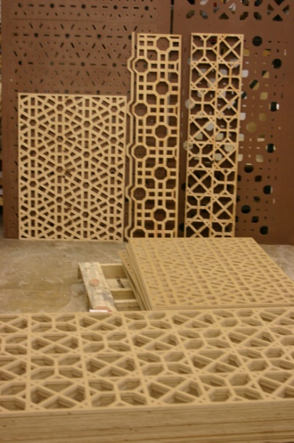
Theatre Design

Slide 12
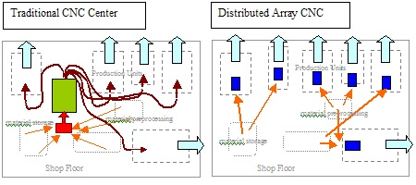
ShopBots in Manufacturing

Slide 13
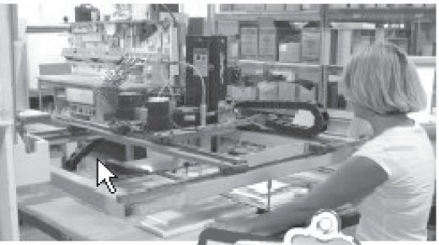
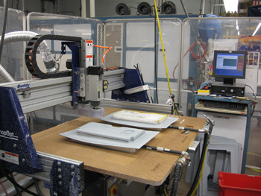
Large Scale
WoodMode
BE AeroSpace

Slide 14
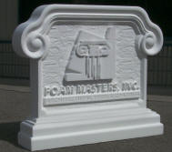
Small Scale
sign makers

Slide 15
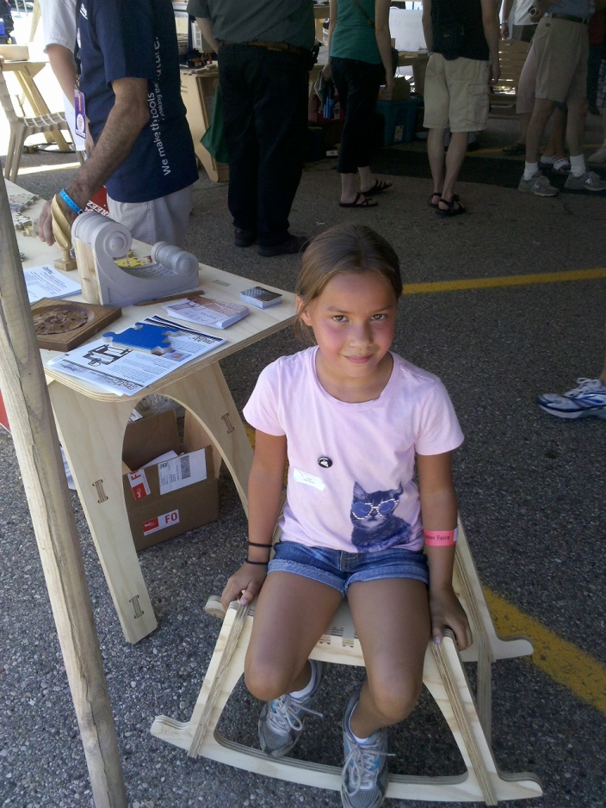
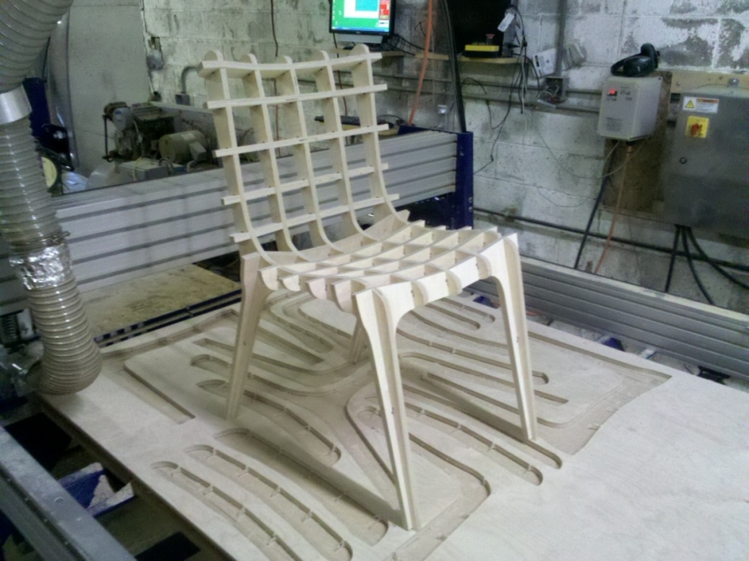
Contract Cutting
www.100Kgarages.com
Pokono
SketchChair

Slide 16
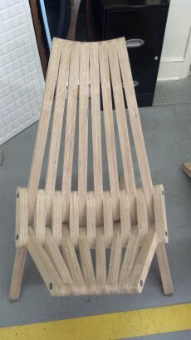
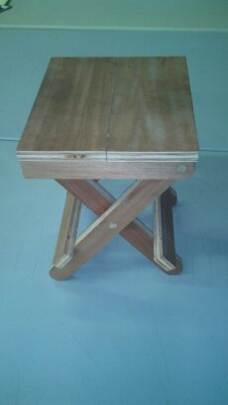
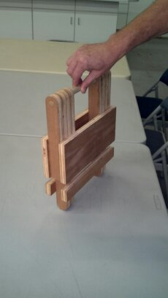
Translation to digital fabrication from existing designs

Slide 17
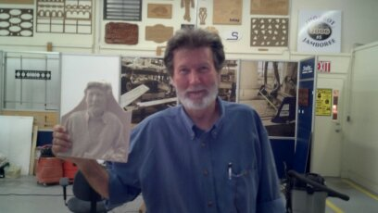
Advances in Software

Slide 18
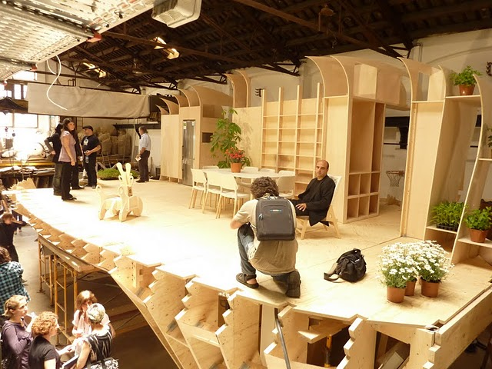
Large Scale Projects
FabLab House
IAAC Barcelona

Slide 19
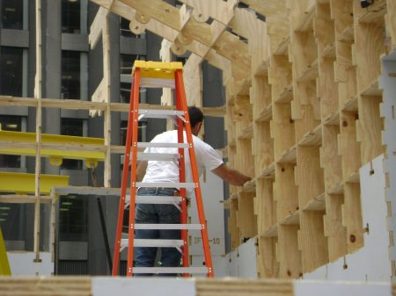
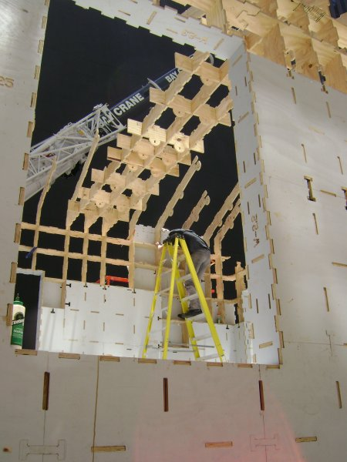
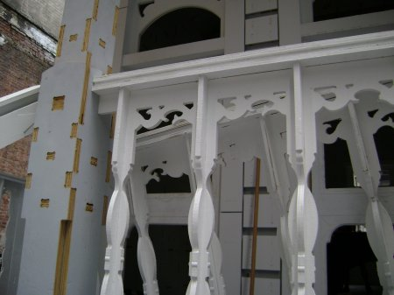
MoMA Home Delivery: Larry Sass

Slide 20
Burning Man Temple : Community Art Makers
Images © 2010 Ira Weinschel All Rights Reserved

Slide 21
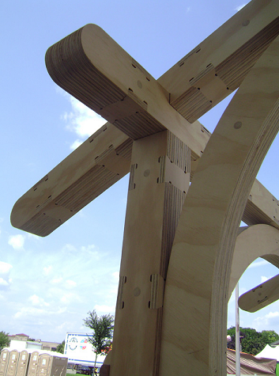
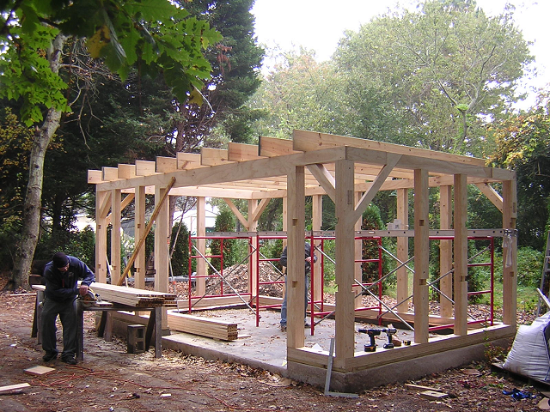
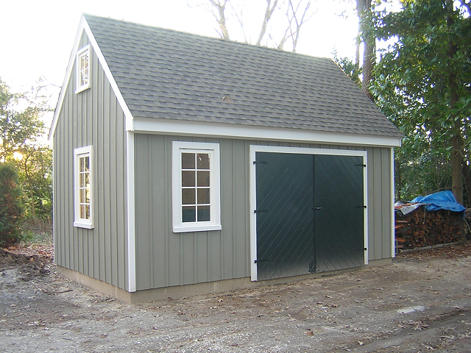
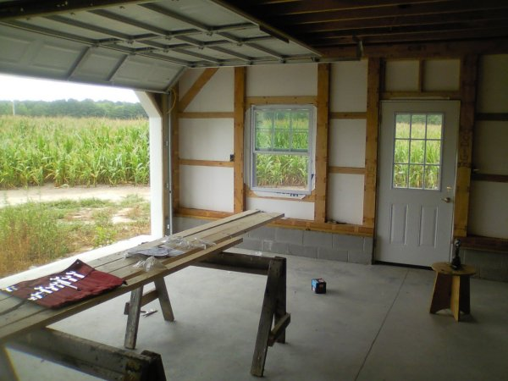
TimberPly construction:
Bill Young and Robert Bridges

Slide 22
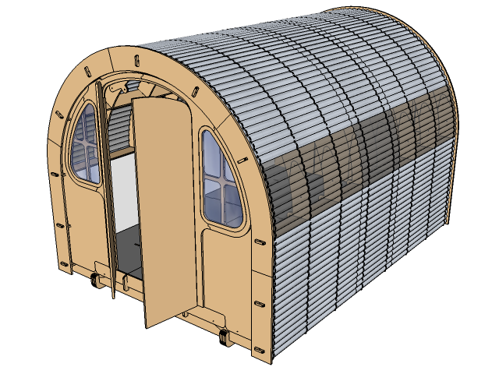
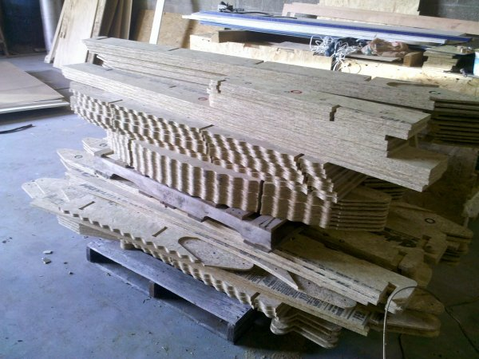
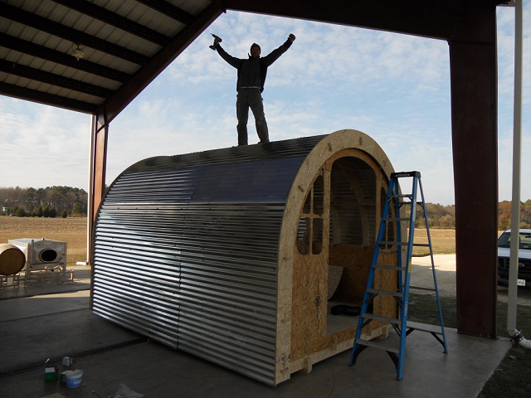
Shelter 2.0: Robert Bridges

Slide 23
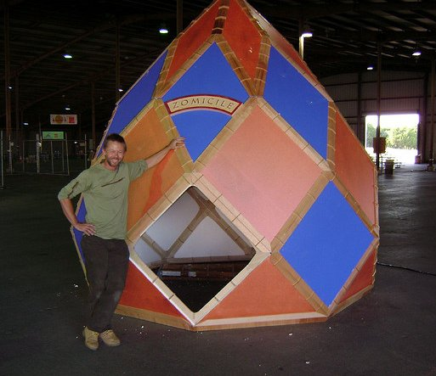
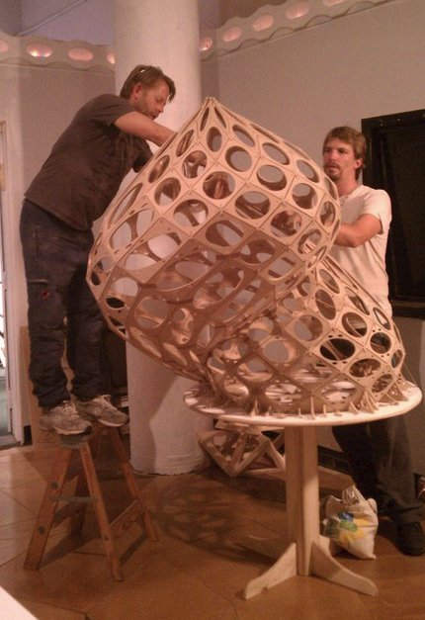
Zomadic: Rob Bell

Slide 24
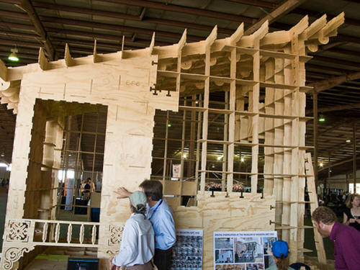
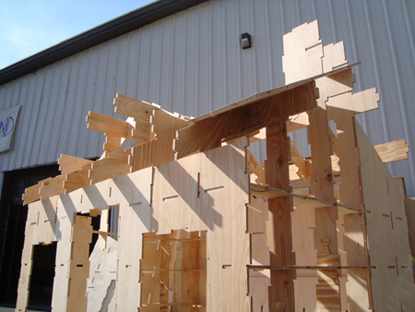
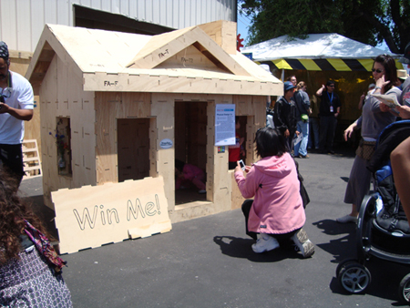
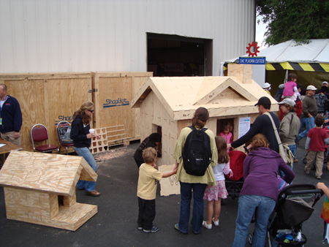
Austin Shed: Physical Design Co.

Slide 25
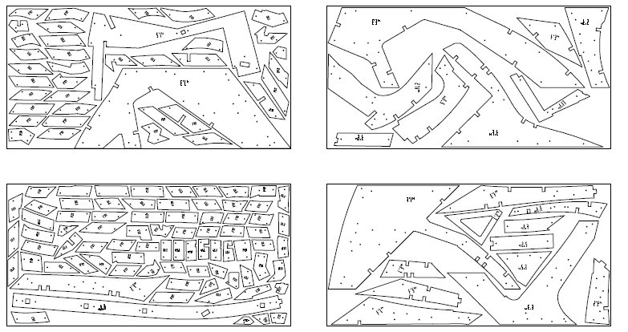
aASHELTER: System Architects:

Slide 26
Tips for large ShopBot projects:
Material handling. Once you get more than 3 or 4 sheets of materials, especially in a small area, it can become difficult to handle the parts, especially if they're small and similarly (but not exactly) shaped. One solution is to create a seperate toolpath that shallowly engraves the part name or number on each part, using a single-stroke font to speed up the process. You can also print out the sheet layouts and mark each parts with it's name or number using a pencil or sharpie.
If there are lots of sheets of parts it may be easier to use tabs to keep the parts captive in their sheets, transport them in full sheets, and then to remove the parts on-site by cutting the tabs with a saw or a router with a trimmer bit. This also makes the project easier to transport...not a lot of loose parts to keep track of.
When cutting a lot of sheets it's easy to get in a flow and lose track of things like your bit getting dull or lost zero. Stop every once in a while to check the cuts and inspect the pieces.
Keep a running list of the sheets that have been cut as you cut them, so that you don't cut a sheet twice or miss a sheet completely.
Try to get all your materials at the same time, so that you don't end up with variations in quality or thickness between batches or suppliers.
If assembly order is an issue, try to plan your cutting so that the parts are cut in the reverse order that you need them... the first parts you need will be the last cut and on the top of the pile.
Scrap and sawdust can build up quickly when doing a lot of cutting...clean up and check any dust collectors frequently.

