Slide 1

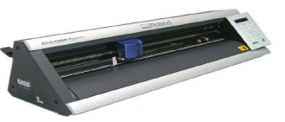
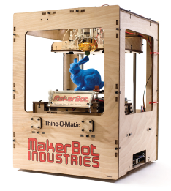
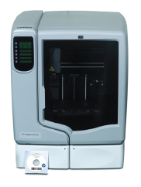
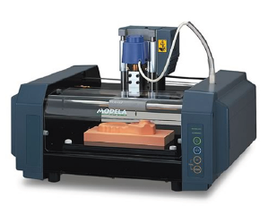
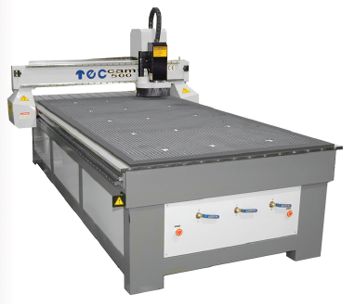
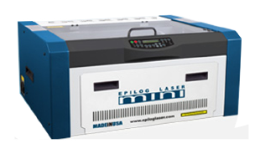
What’s FabLab Leon?
Technology on the ground → Digital fabrication on our city.
Learning by doing →Stimulate science and technology, especially on young people, by a different way of education, learn it making it.
Proactive aptitude → If you can think it, here you have de place to learn, to work in it, and finally to make it yourself.

Slide 2


www.fablableon.org
Contact:
info@fablableon.org / rferrero@fablableon.org

