Slide 1

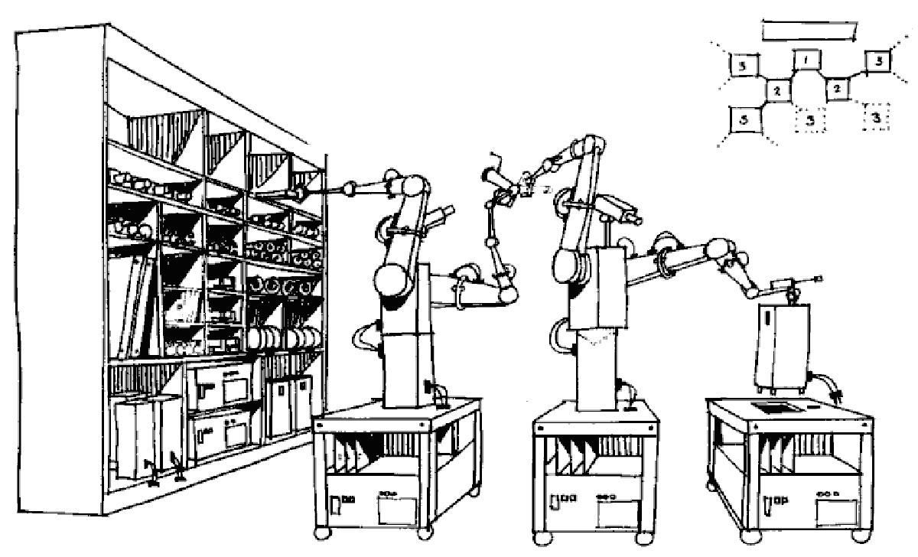

Fabricational Complexity
MIT Molecular Machines (Jacobson) Group
jacobson@media.mit.edu
3.9.13

Slide 2

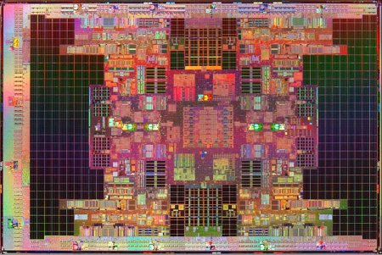
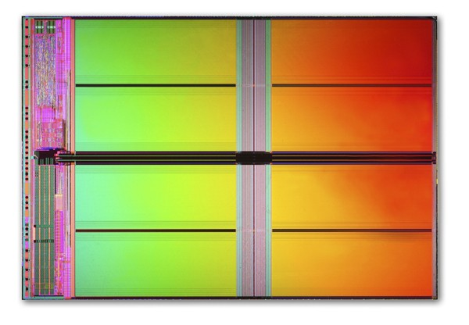
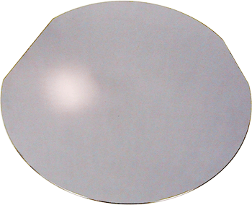
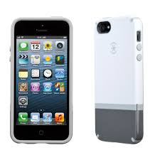
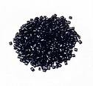
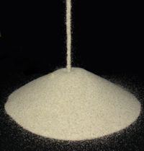
What Drives The Cost of Placing Atoms Where We Want Them? What are The Fundamental Limits?
Itanium Quad Tukwila
Transistor Count: 2B
Cost: ~$50
Flash Memory
Transistor Count: 2B
Cost: ~$3
Si Wafer with Area sufficient for
2 Billion Transistors
Cost: ~$0.50
SmartPhone
Cost: ~$200
Sand (Chips and Screen)
Cost: ~$0
Plastic Resin / Metal Ore
Cost: ~$4

Slide 3
Fabricational Complexity
A
A | G | C | T
T | C | T | G
C | A | C | G
T
G
N BLOCKS
C
Fabricational Complexity for N Blocks or M Types =
Fabricational Cost for N Blocks =
Where is the Yield Per Fabricational Step
Fabricational Complexity Per Unit Cost
Complexity Per Unit Cost
Complexity Per Unit Time*Energy

Slide 4
Complexity Per Unit Cost

Slide 5
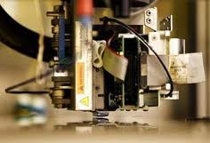
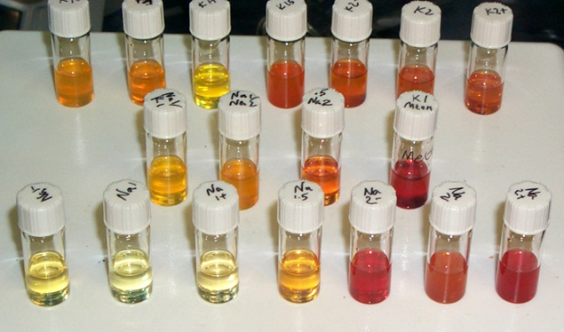
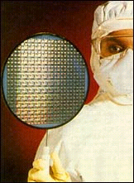
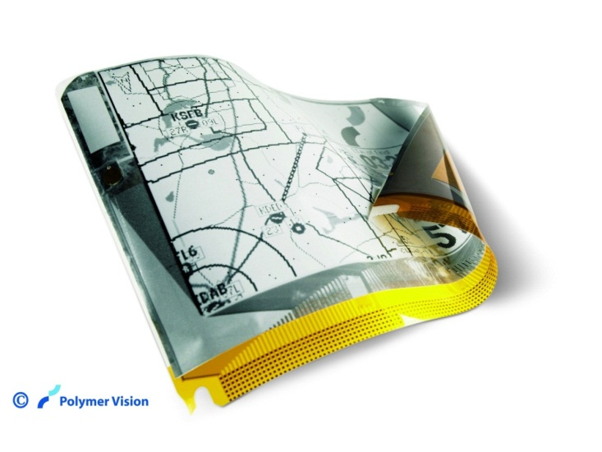
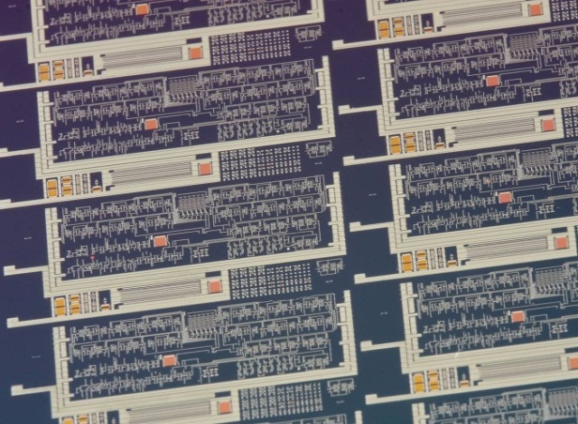

Printed Electronics
Towards $10 Tablets & E Books
Lithography
Printed Electronics
[1] Ridley et al., Science, 286, 746 (1999)
Science 297,416 (2000)
+
Liquid Inorganic
Semiconductors^{[1]}
Printing
~ 3Weeks of
7x24 Processing
~Minutes
Notes:
Why does a lapto cost more than a newspaper?
Chip takes 2 weeks x 7 days a week x 24 hrs to make. Made in a $2 Billion dollar fab.
Maximally interesting world - as many people as possible involved in the inventive process.

Slide 6
Fabricational Complexity
A
A | G | C | T
T | C | T | G
C | A | C | G
T
G
N BLOCKS
C
Fabricational Complexity for N Blocks or M Types =
Fabricational Cost for N Blocks w/ Error Correction =
Where is the Yield Per Fabricational Step
Fabricational Complexity Per Unit Cost
Complexity Per Unit Cost
Complexity Per Unit Time*Energy

Slide 7
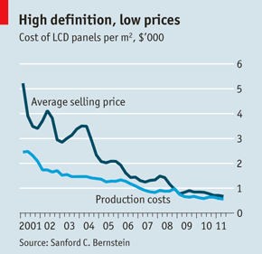
Yielding N Devices with Error Correction
(Why A Small Amount of Error Correction Has A Very Large Effect)
N Devices
Fraction of Chips with M or More Perfect Devices (i.e. N-M or Fewer Errors).
0.75 | 0.97 | 0.997 | 0.9998
0.5 | 0.85 | 0.97 | 0.99
0.25 | 0.60 | 0.84 | 0.95
0.1 | 0.33 | 0.60 | 0.80
0.01 | 0.06 | 0.16 | 0.32
Table 1. Yields as a function of the number of repaired errors.
J. Jacobson 02/12/09

Slide 8
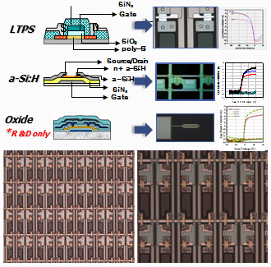
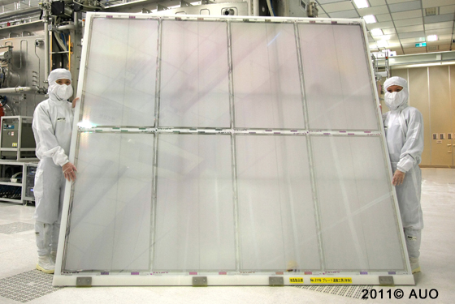
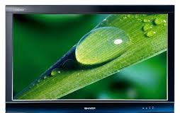
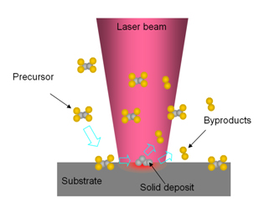
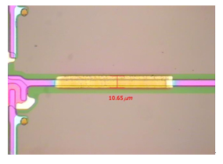
Error Correcting
Fabrication - TFT
http://www.sdtech.co.kr/device3.html
http://laser.gist.ac.kr/board/bbs/board.php?bo_table=rese_02
http://www.sdtech.co.kr/data/file/pro03/1890065063_Z6N9yvt4_EC9DB4EBAFB8ECA780_1.jpg

Slide 9
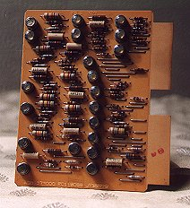
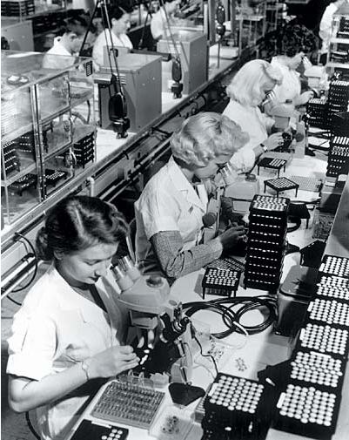
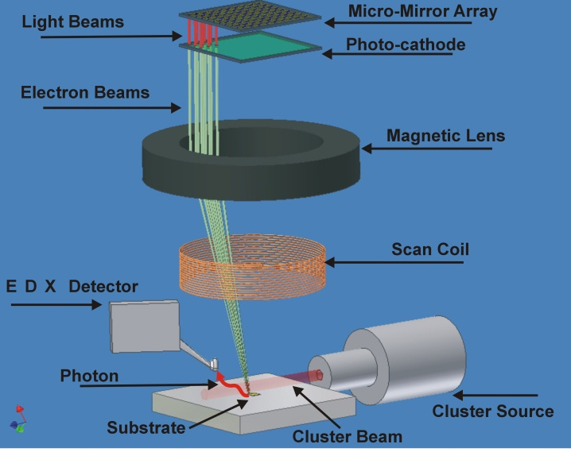
Moore’s Law Without Moore’s 2nd Law
Error Correcting Manufacturing
Error Corrected TFT
Error Corrected CMOS
Error Corrected DNA Synthesis
Moore’s Law
Super Geometric Scaling
Exponential Resource -> Exponential Gain
Linear Resource-> Exponential Gain
http://www.webenweb.co.uk/museum/comps.htm
http://www.chipsetc.com/the-transistor.html

Slide 10
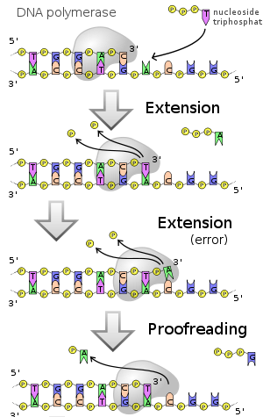
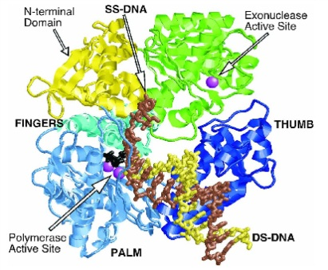
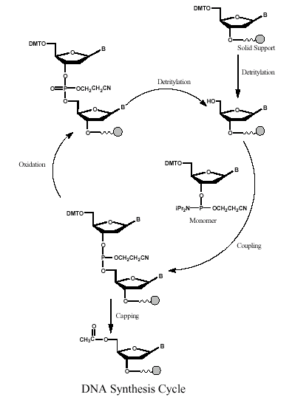
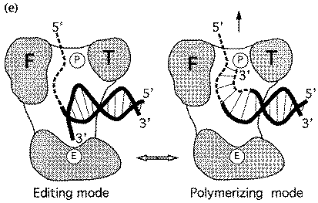
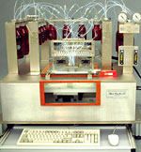
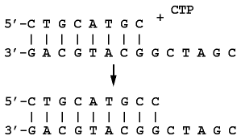
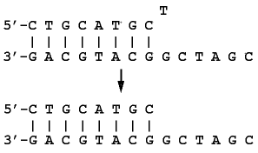
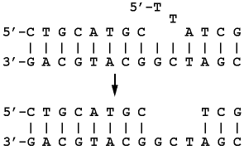
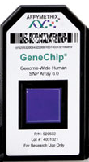
DNA Synthesis
Chemical Synthesis (Open Loop Protection Group) | Biological Synthesis (Error Correcting Polymerase)
Error Rate: 1:10² Throughput: 300 S per Base Addition http://www.med.upenn.edu/naf/services/catalog99.pdf
Throughput Error Rate Product Differential: ~10⁸
Error Rate: 1:10⁶
Throughput: 10 mS per
Base Addition
Beese et al. (1993), Science, 260, 352-355. http://www.biochem.ucl.ac.uk/bsm/xtal/teach/repl/klenow.html
template dependant 5'-3'
primer extension
3'-5' proofreading
exonuclease
5'-3' error-correcting
exonuclease
Example: [A] Synthesize 1500 Nucleotide Base Gene. Error Rate = 0.99
(0.99)¹⁵⁰⁰ ~ 10⁻⁷. [B] 3000 Nucleotide Base Gene. (0.99)³⁰⁰⁰ ~ 10⁻¹³.

Slide 11
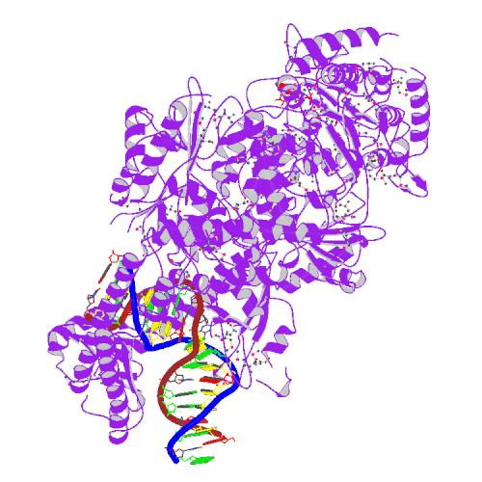
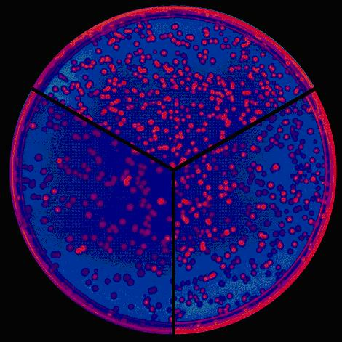
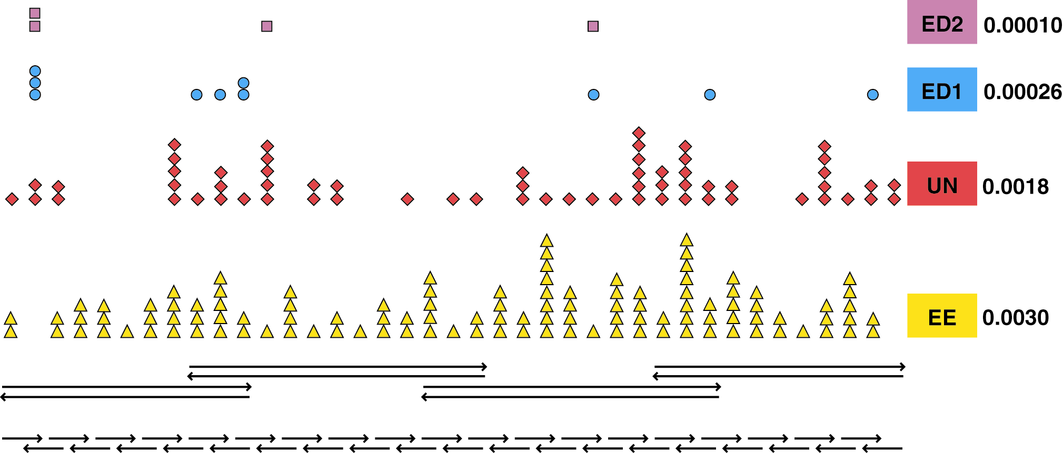
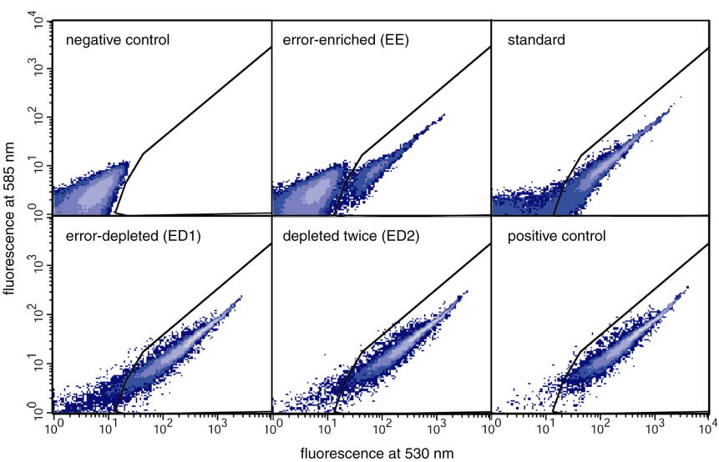
Error Correcting Gene Synthesis
X
X
X
Error Rate 1:10⁴
Lamers et al. Nature 407:711 (2000)
Nucleic Acids Research 2004 32(20):e162
Nucleic Acids Research 2004 32(20):e162

Slide 12
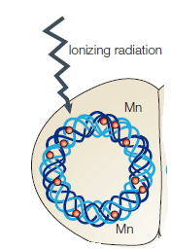
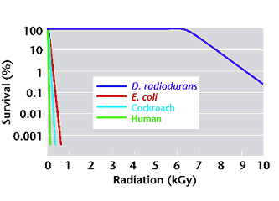
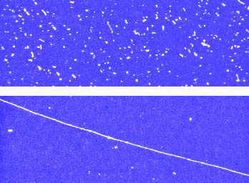
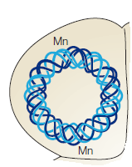
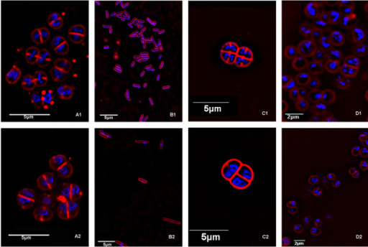
Deinococcus radiodurans
(3.2 Mb, 4-10 Copies of Genome )
Nature Biotechnology 18, 85-90 (January 2000)
D. radiodurans
1.75 million rads, 0 h
D. radiodurans
1.75 million rads, 24 h
D. radiodurans: 1.7 Million Rads (17kGy) – 200 DS breaks
E. coli: 25 Thousand Rads – 2 or 3 DS breaks
http://openi.nlm.nih.gov/imgs/rescaled512/1079854_1471-2180-5-17-11.png
photos provided by David Schwartz (University of Wisconsin, Madison)]
http://www.ornl.gov/hgmis/publicat/microbial/image3.html

Slide 13
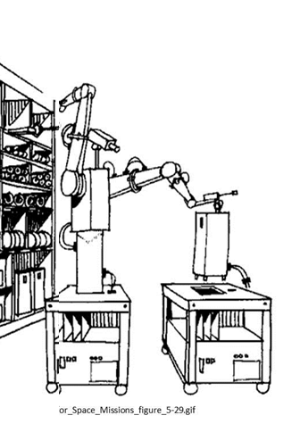
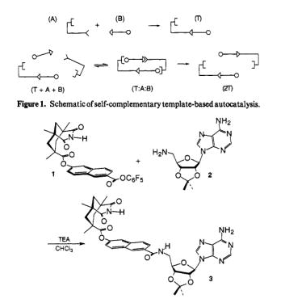
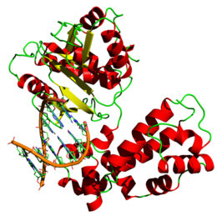
Synthetic Complexities of Various Systems
Atoms: ~ 20 [C,N,O]
Complexion: W~ 3²⁰
ξ = 32
Complexity (uProcessor/program):
ξ ~ 1K byte = 8000
Nucleotides: ~ 1000
Complexion: W~4¹⁰⁰⁰
ξ = 2000 = 2Kb
DNA Polymerase
Product: C = 4 states
ξ = 2
Product: C = 4 states
ξ = 2
Product: 10⁷ Nucleotides
ξ = 2x10⁷
ξ[Product / Parts] =~ .00025
ξ[Product / Parts] =~ .0625
ξ[Product / Parts] =10⁴
ξ >1 Product has sufficient complexity to encode for parts / assembler

Slide 14
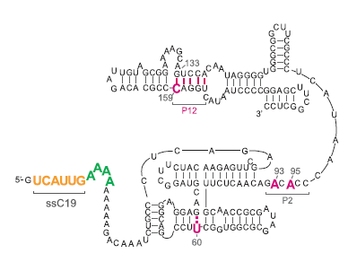
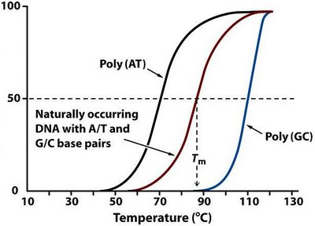
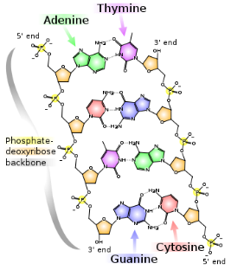
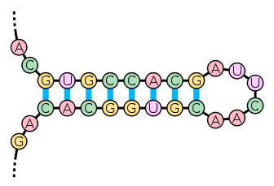
Threshold for Life
What is the Threshold for Self Replicating Systems?
Measurement Theory
DNA
Error Correcting
Exonuclease
(Ruler)
Watson Crick
.18 nm
/sandwalk.blogspot.com/2007/12/dna-denaturation-and-renaturation-and.html
http://en.wikipedia.org/wiki/File:Stem-loop.svg
How Well Can N Molecules Measure Distance?
Probability of Self Replication
Threshold length: 1541 bp for 50% yield. 379 bp for 10⁻⁶ yield.
Number of Nucleotides

Slide 15
Threshold for Life
What is the Threshold for Self Replicating Systems?
Measurement Theory
Threshold for assembling blocks of m –mers (monomer, dimer , trimer etc.)
The longer the block the greater the binding energy.
Threshold Machine Complexity N
for Self-Replication
Yield
___ 50%
___ 10%
___ 1%
___ 1E-6
Minimum Machine Size N
To be Self-Replicating
m | N for 50% Yield | Number of Build Steps
1 (A,G,T,C) | 1541 | 1541
2 (AA,AG,AT …) | 1381 | 691
3 (AAA,AAG…) | 1286 | 429
10 | 994 | 100
50 | 564 | 12
100 | 336 | 4
123 | 245 | 2
Number of Nucleotides m
Per Building Block

Slide 16
NOTES

