Slide 1
Frontiers in 3D scanning
Prof Phil Withers
Manchester X-ray imaging Facility
University of Manchester

Slide 2
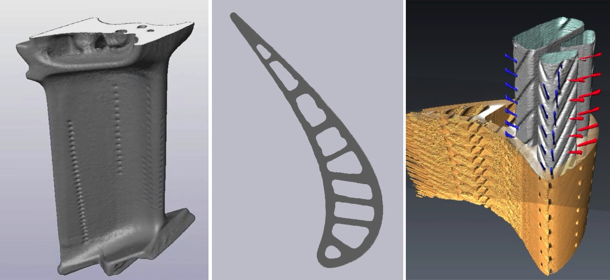
Volume Scanning
Computer Tomography (CT)
The great advantage of computer tomography is that not only do you get the external surface geometry you capture any internal features as well.
The principle is simple; namely to collect a series of 2D projections acquired from different angles from which an image of the original 3D volume can be reconstructed using a computer algorithm
Range of resolutions from mm to tens of nanometers

Slide 3
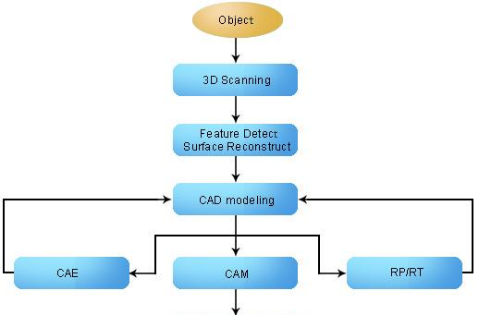
From 3D object to 3D fabrication
3D fabrication

Slide 4
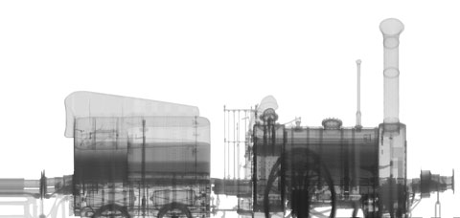
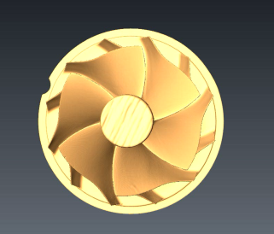
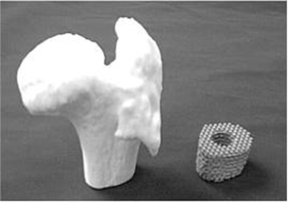
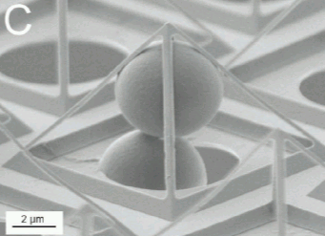
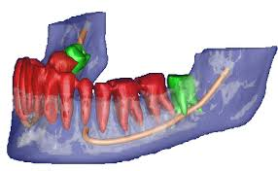

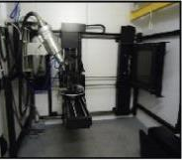
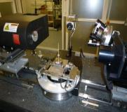
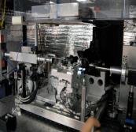
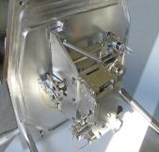



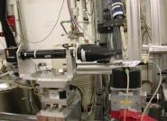
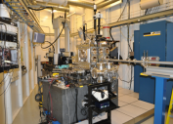
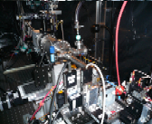
Multiscale 3D Imaging for Fabrication
Resolution length scales
1mm
10 μm
1 μm
50 nm
5 nm
Electron
Lab. X-ray
Synchrotron X-ray

Slide 5
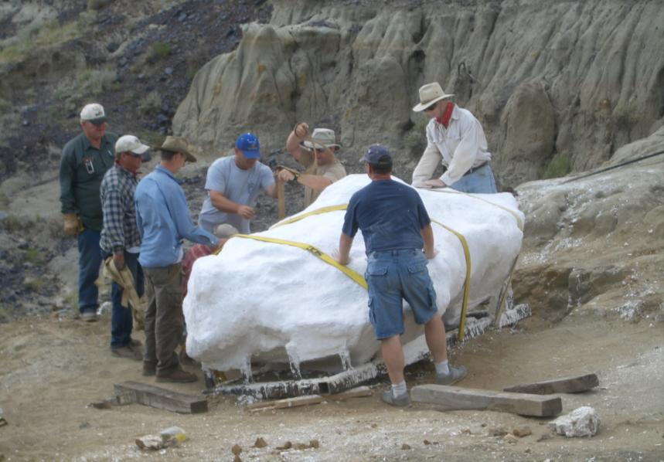
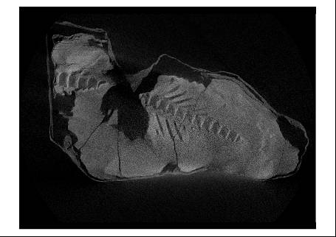
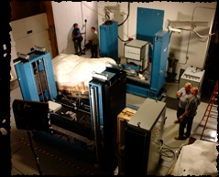
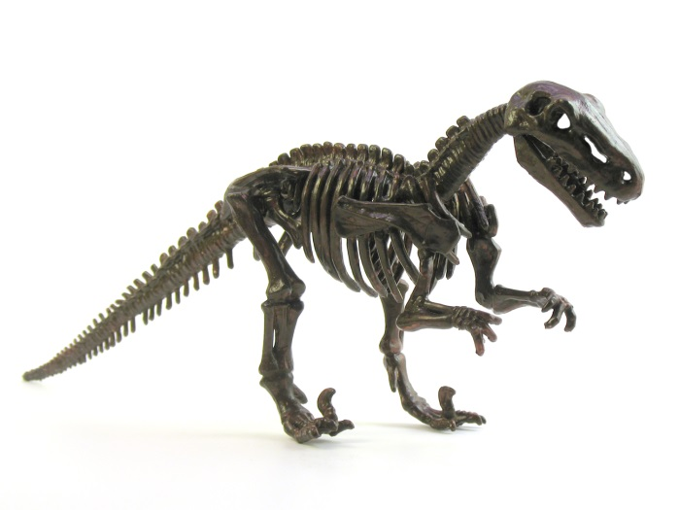
Very Large object scanning
Lab X-ray systems
200μm spatial resolution
6MeV X-ray Source
Accurate 3D model

Slide 6
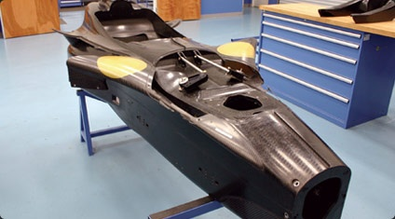
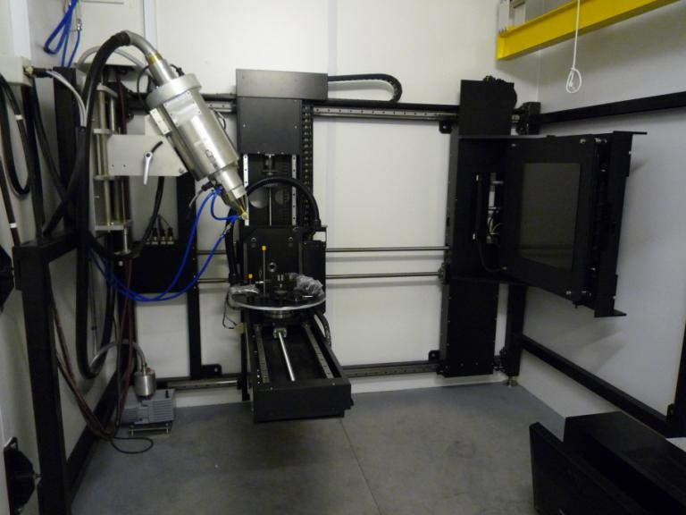


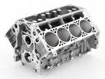
Large object imaging
5μm resolution (say);
320kV microfocus
500mm objects
5-axis 100kg capacity CT manipulator

Slide 7
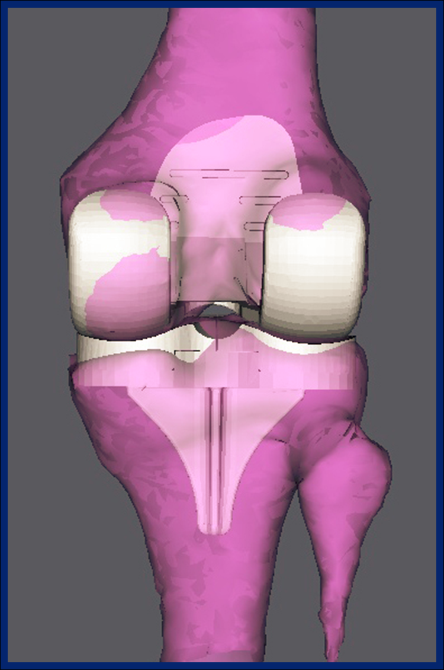
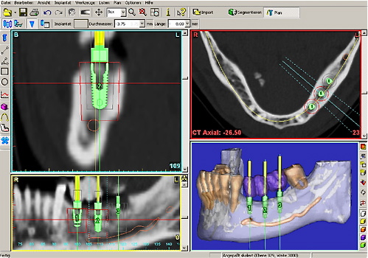
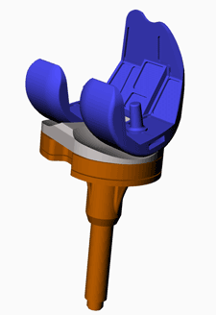
Large object fabrication
Tailored implant design

Slide 8
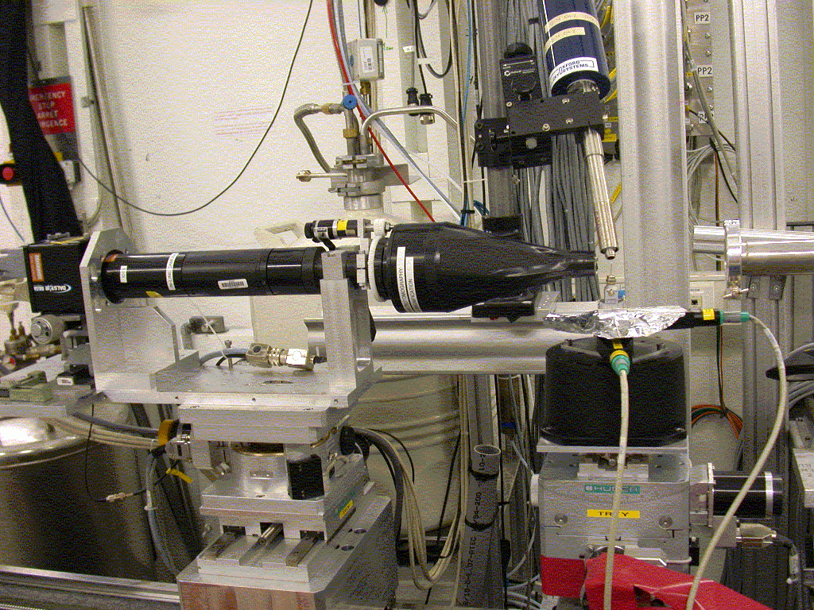

Micron Scale
0.7-1.0μm spatial resolution (Lab or synchrotron)
150mm max samples size typical
Synchrotron 1 tomograph per second/Lab 1 per 4 hours

Slide 9
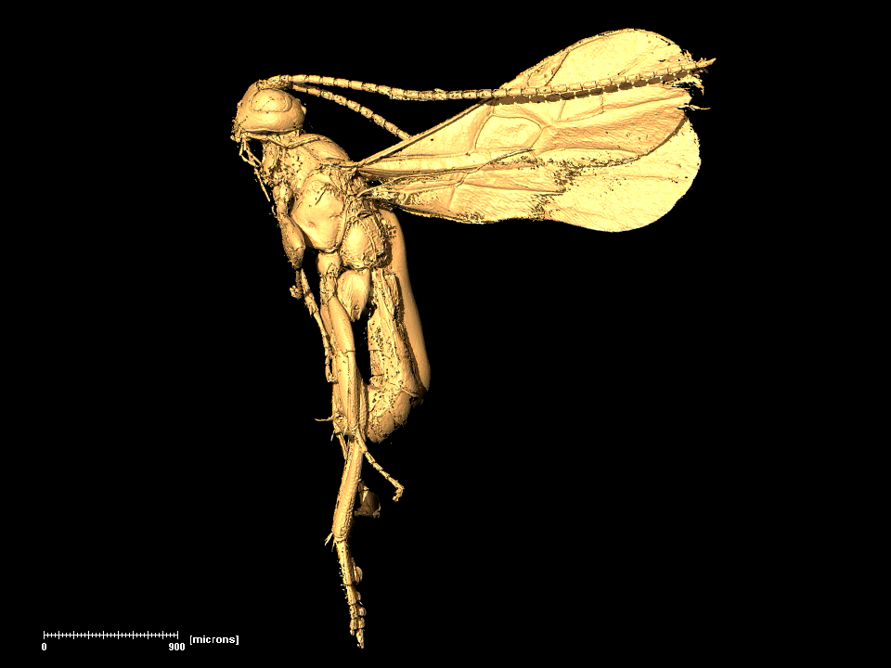
Phase contrast
1mm
Wasp
fossil
Notes:
Zn-oxide is artificially grown with anodic polarisation - and you would expect (a) Zn wire in the core -
(ii) a less dense region + eventually some cavities + (iii) a dense / compacted layer (may be with some pores - thats' what I should have a loook at) (iV) an outer layer with many pores and some crystalls !

Slide 10
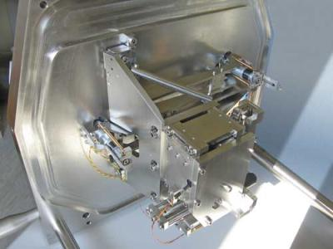
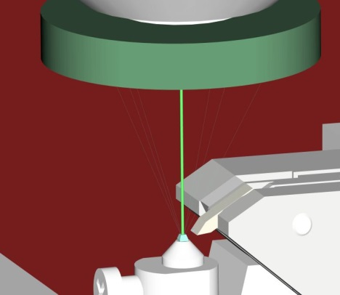
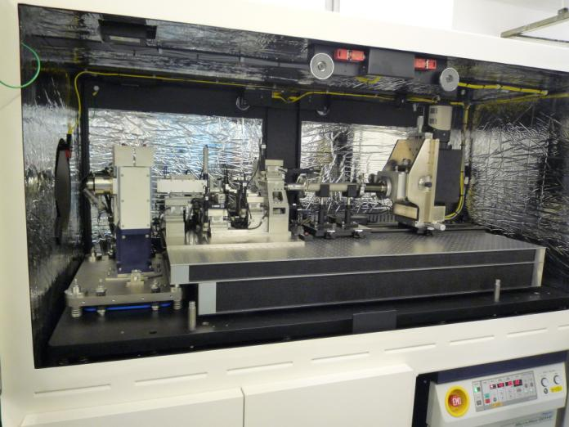
Nanotomography (50nm)
In scanning electron microscope systems
Lens based lab. X-ray systems
In SEM serial sectioning
In SEM X-ray CT

Slide 11
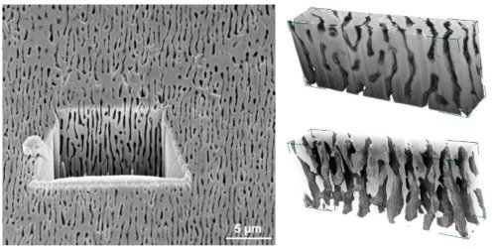
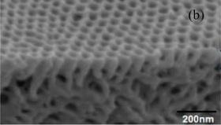
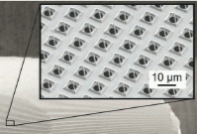
Nanotomography (50nm)
Tailored optics/mircofluidics, MEMS devices, membranes, etc
Berenschot et al.

Slide 12
Concluding remarks
A range of modalities for scanning objects in true 3D (including interior structure)
X-ray energy must be higher the larger the object
Electron tomography well suited to 3D scanning at submicron scales
Packages exist to convert 3D tomography images to CAD for 3D fabrication

