Slide 1
Masterless MapReduce
Programming the “Cloud-in-a-Can”
Bill Butera
April, 2008

Slide 2
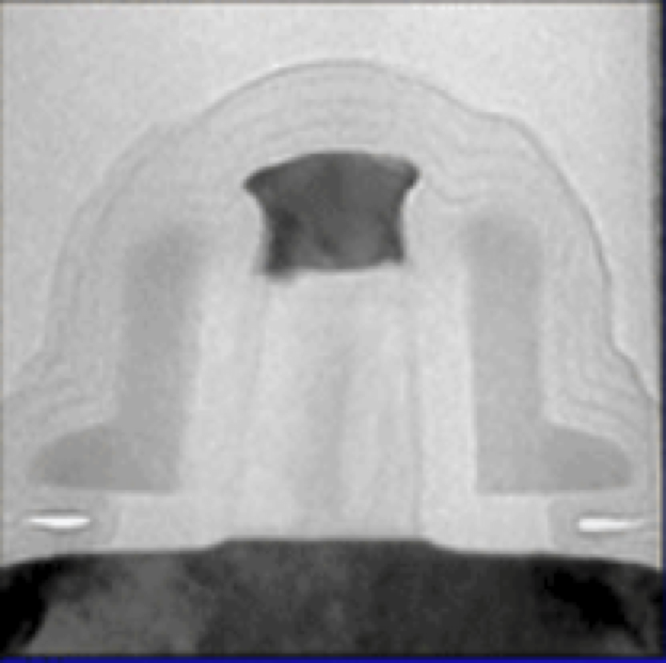
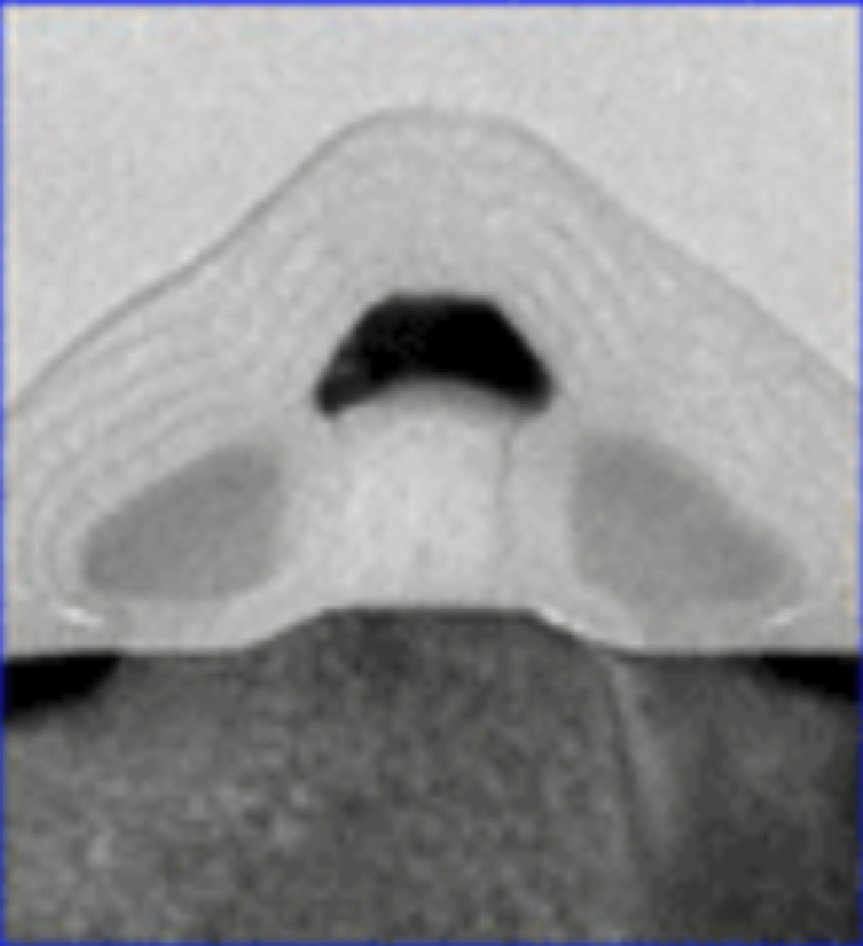
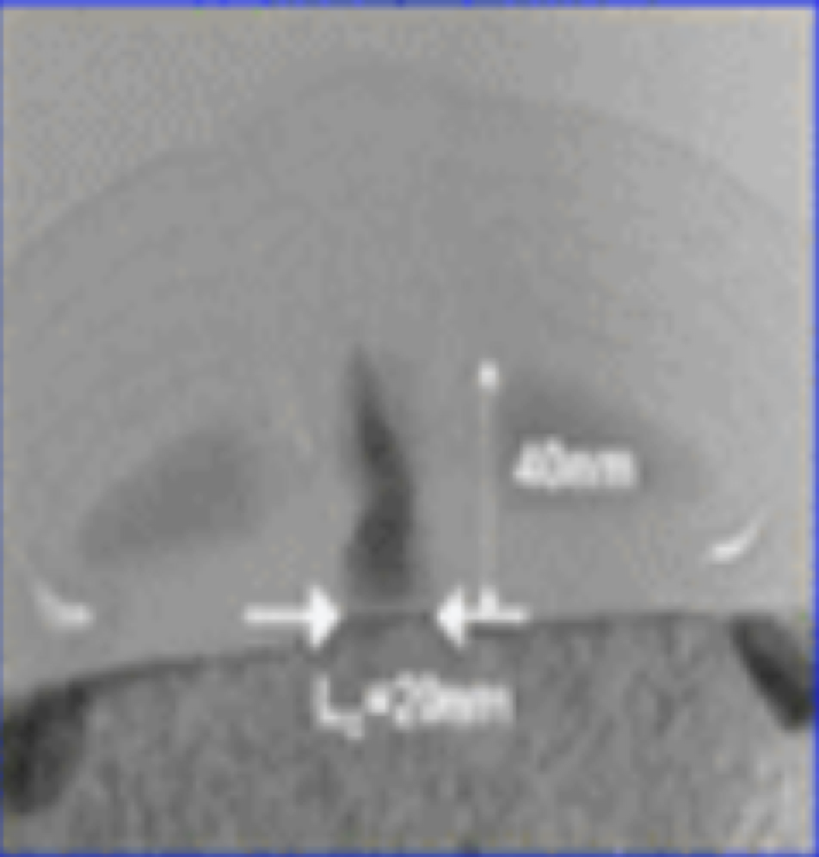
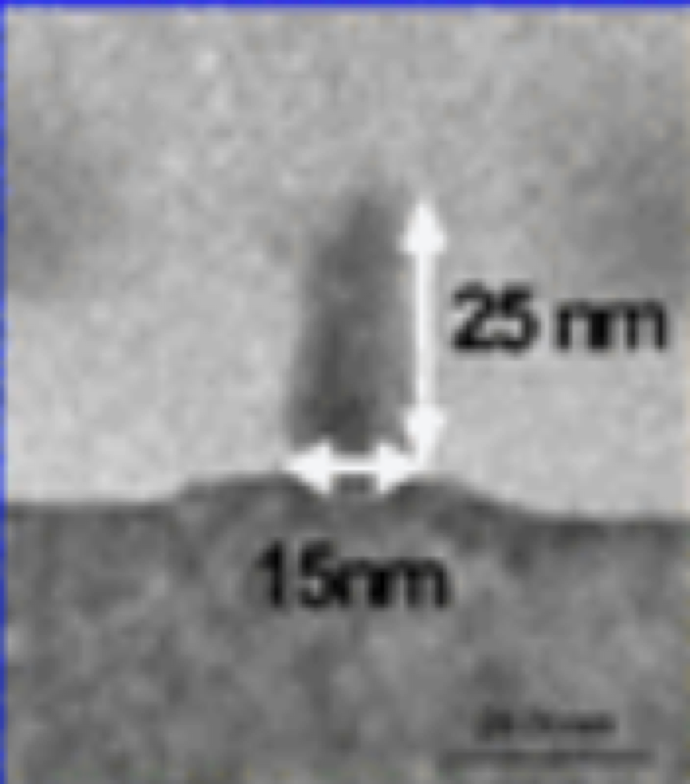
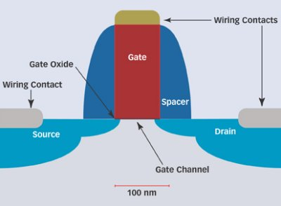
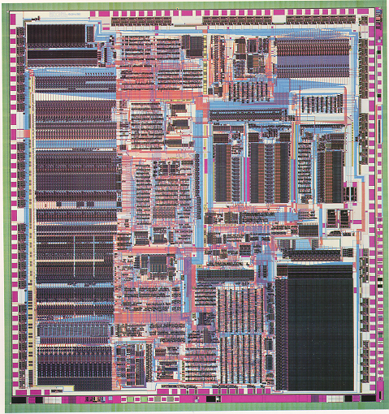
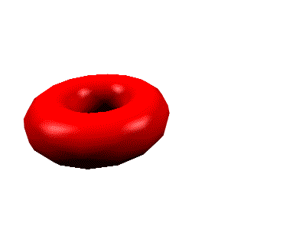
Technology Drivers: Device Physics and Micro-Architecture
50 nm Lgate
30 nm Lgate
20 nm Lgate
15nm Lgate
Source: Intel Corporation
2011
When does L_{gate} = 22nm ?
80 µ
die area of an ARM7 at 22nm ?

Slide 3
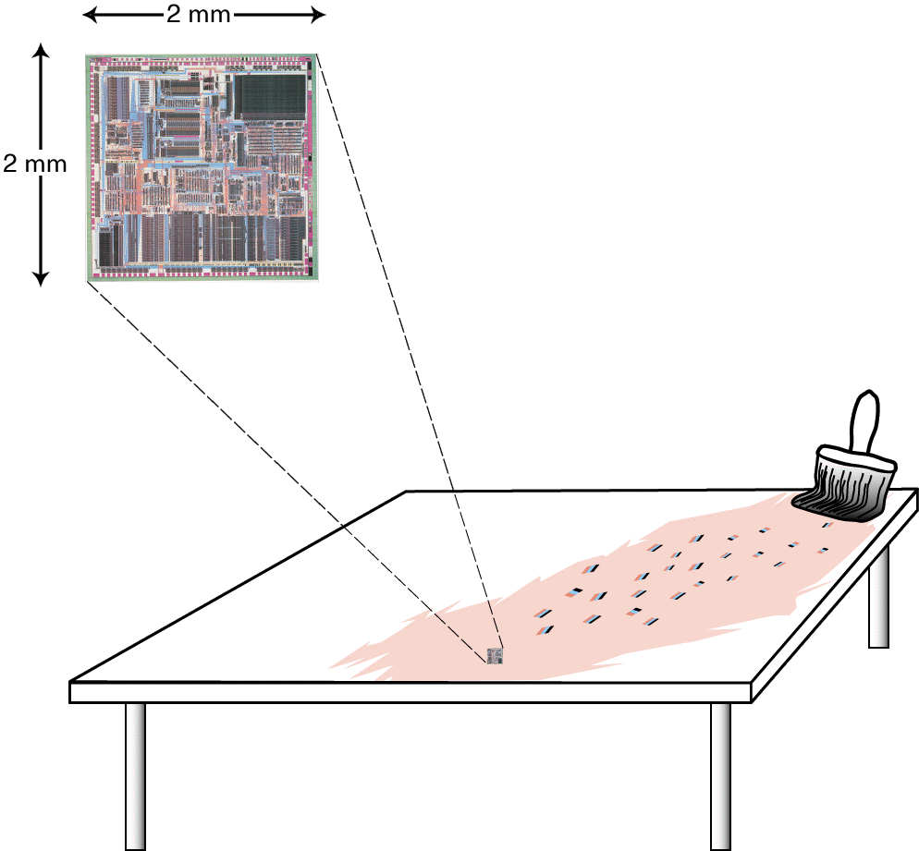
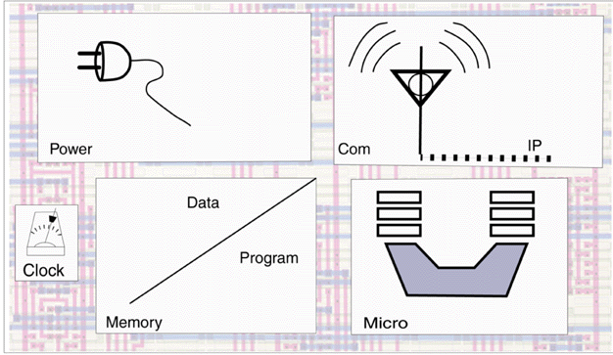
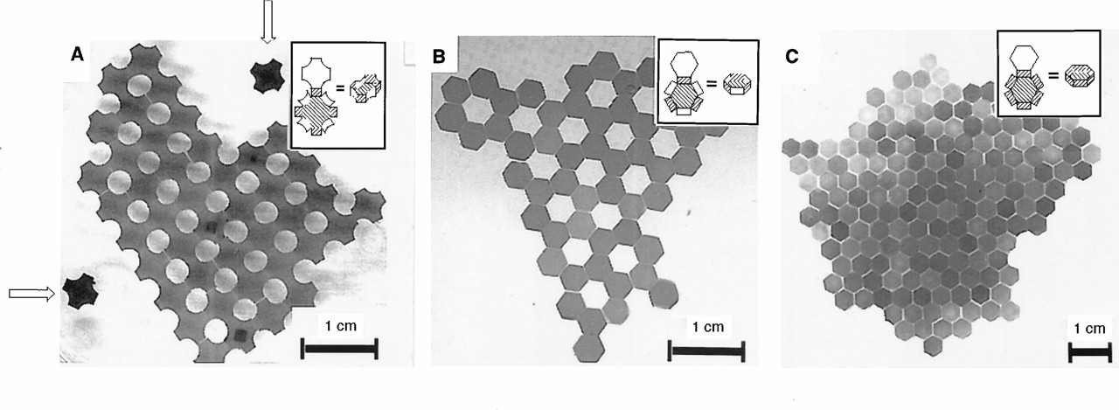
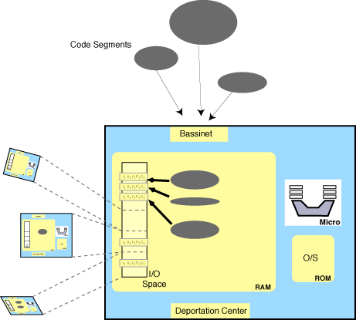
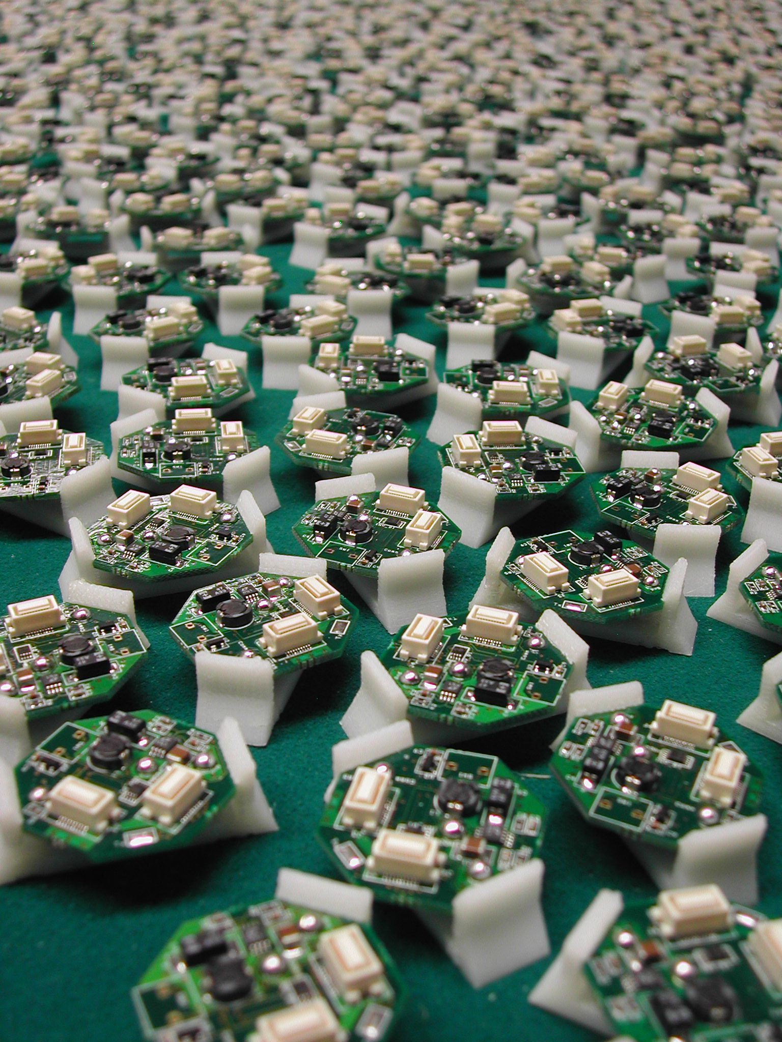
Paintable Computing 2000 - 2004
Vision
Hardware
Abstraction
Software
Abstraction
Programming
Model
Emulation
Hardware
Applications

Slide 4
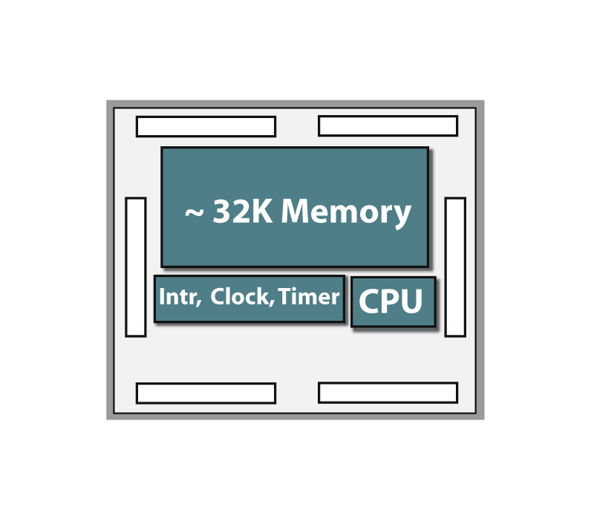
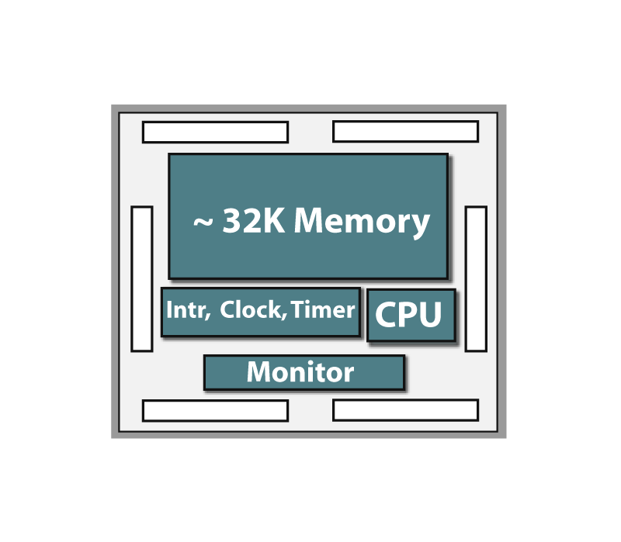
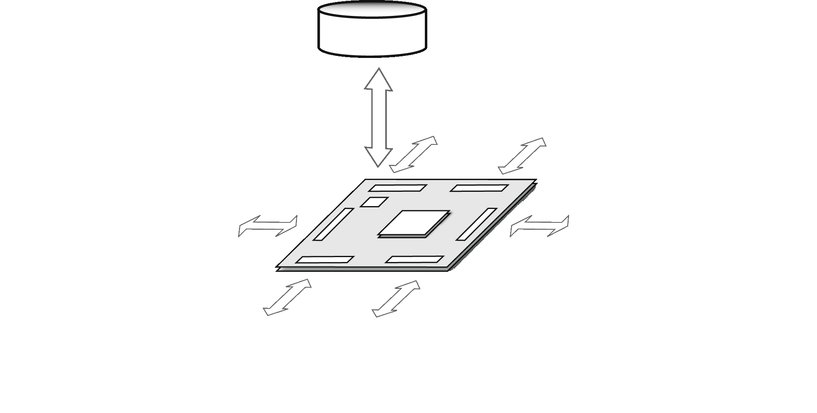
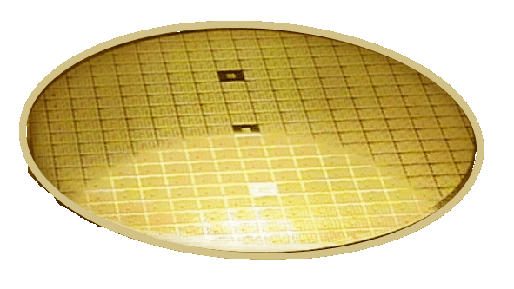
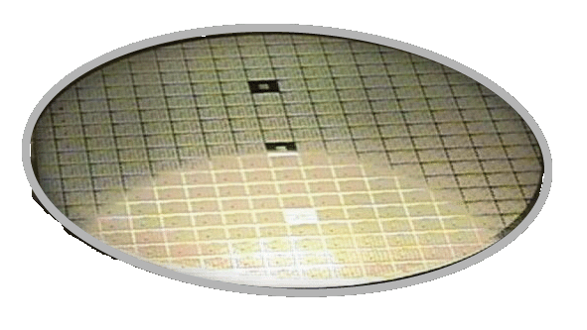
Si Hardware Environment
+30 %
nominal
-30 %
inactive
Notes:
Node:
Core: ARM7TDMI
Clock: ~250 MHz
Memory: ~64KB FBM
Interconnect: 2D mesh
2D Mesh:
Message passing & distributed memory
Meso-synchrony between nodes
3D Stack
Simulated in 2D
Questions:
What does this computation look like on an SFA?
Over what range of M, N, and P can it be done in real time?
Extra credit: MapReduce & Error resilience.

Slide 5
Canonical MapReduce
A selecting worker pool
B data partitioning / split assignment
C worker assignment (Map & Reduce tasks)
D load balancing / performance monitoring
E grouping criteria for shuffle
F routing results to storage
G execution sequencing
Master
Map
Shuffle
Reduce
Map
Reduce
Map
Notes:
Slide takeaways:
The dynamics of the search procedure conforms the the MapReduce construct popularized by Google.
The throughline from API to running code is still incomplete (i.e. no compiler to pfrags)
To the degree that Search and MapReduce is isomorphic with the “personal Media Manager”, this work is “early warning” for a potential killer app. Long in advance of earlier predictions.
A key requirement for acceptance is growing the pool of programmers. As a suggestion of how we might go about that, consider the case of MapReduce; a parallel programming construct popularized by Google. In our case, we would regard MapReduce as an API that abstracts the programmer from the particulars of a given multi-processor system (i.e. the topology or instantaneous performance variance across the nodes).
The SFA flavor of Search can be expressed as a MapReduce procedure while preserving the key attributes.
This is noteworthy because – to the degree that Search and MapReduce are isomorphic with “Personal Media Ming” – we have a candidate killer app for SFA’s much earlier than originally envisioned.

Slide 6
“Masterlets”: Distributed Concurrency Management
a
A
selecting worker pool
Master
b
B
data partitioning / split assignment
C
c
c
worker assignment (Map & Reduce tasks)
d
load balancing / performance monitoring
d
d
D
d
d
e
a
E
grouping criteria for shuffle
a
a
F
a
a
a
a
a
a
a
a
f
routing results to storage
a
a
a
a
G
execution sequencing
Map
Shuffle
d
e
b
d
c
d
d
e
Reduce
Map
d
e
c
d
d
f
b
d
c
d
d
e
Reduce
Map
Notes:
Slide takeaways:
The dynamics of the search procedure conforms the the MapReduce construct popularized by Google.
The throughline from API to running code is still incomplete (i.e. no compiler to pfrags)
To the degree that Search and MapReduce is isomorphic with the “personal Media Manager”, this work is “early warning” for a potential killer app. Long in advance of earlier predictions.
A key requirement for acceptance is growing the pool of programmers. As a suggestion of how we might go about that, consider the case of MapReduce; a parallel programming construct popularized by Google. In our case, we would regard MapReduce as an API that abstracts the programmer from the particulars of a given multi-processor system (i.e. the topology or instantaneous performance variance across the nodes).
The SFA flavor of Search can be expressed as a MapReduce procedure while preserving the key attributes.
This is noteworthy because – to the degree that Search and MapReduce are isomorphic with “Personal Media Ming” – we have a candidate killer app for SFA’s much earlier than originally envisioned.

Slide 7
Preserving the MapReduce Abstraction
Production
Research
5-stage Sequencer
T e m p l a t e
C O M P I L E R
Lib:
Pfrag Control
c
Worker assignment
M a s t e r
a
Hints
d
Load balancing
b
c
Payload
Map
Map procedure
d
e
c
Map
Reduce
Pfrag
R
R
d
R
Map
M
M
M
Notes:
Slide takeaways:
The dynamics of the search procedure conforms the the MapReduce construct popularized by Google.
The throughline from API to running code is still incomplete (i.e. no compiler to pfrags)
To the degree that Search and MapReduce is isomorphic with the “personal Media Manager”, this work is “early warning” for a potential killer app. Long in advance of earlier predictions.
A key requirement for acceptance is growing the pool of programmers. As a suggestion of how we might go about that, consider the case of MapReduce; a parallel programming construct popularized by Google. In our case, we would regard MapReduce as an API that abstracts the programmer from the particulars of a given multi-processor system (i.e. the topology or instantaneous performance variance across the nodes).
The SFA flavor of Search can be expressed as a MapReduce procedure while preserving the key attributes.
This is noteworthy because – to the degree that Search and MapReduce are isomorphic with “Personal Media Ming” – we have a candidate killer app for SFA’s much earlier than originally envisioned.

Slide 8
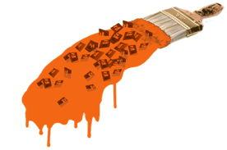
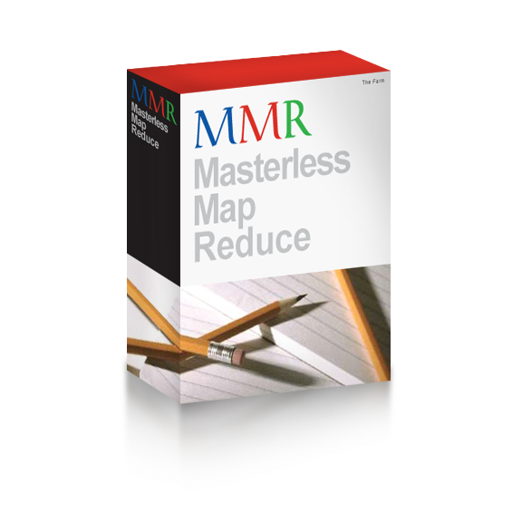
Credits :
MIT – Media Lab / CBA
Conformal Computing
DARPA
Paintable Displays / RF-nixel
MIT - CSAIL
Amorphous Computing
Intel
DEG Architecture & Planning
MIT - CSAIL
Amorphous Computing
Gary Bradski
Harvard
Project class — CS 266 Fall ‘06
Intel
DEG Architecture & Planning
MIT - CSAIL
Amorphous Computing
Google - Boston
MapReduce immersion class

Slide 9
Backup

Slide 10
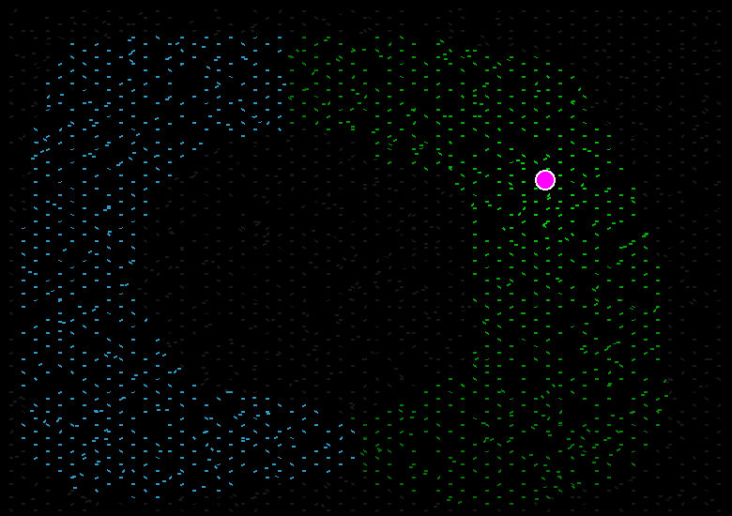
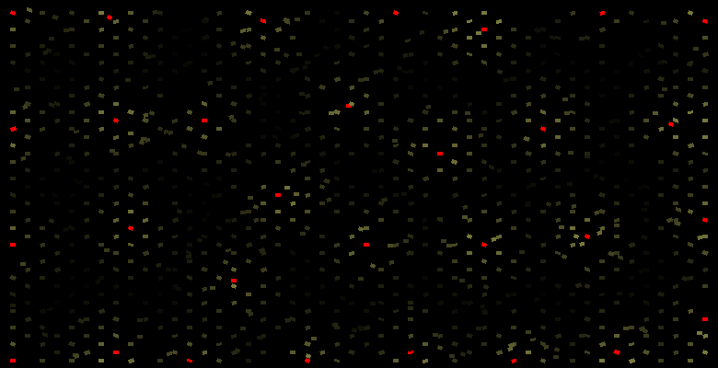
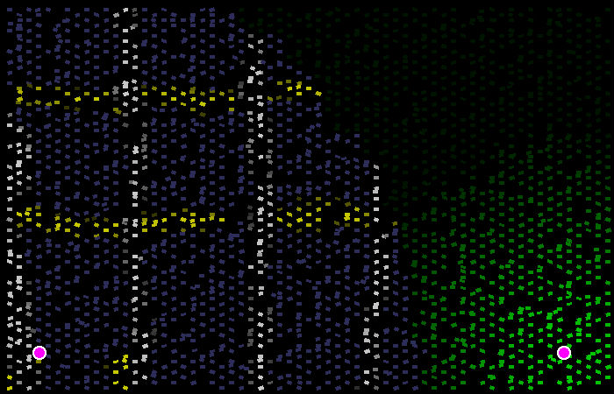
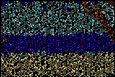
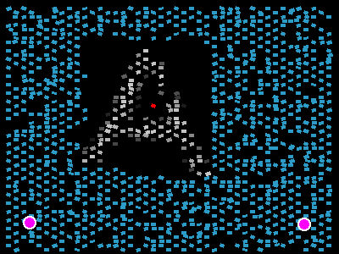
Paintable Computing Libraries and Applications
Gradients
Tessellation
Coordinate Systems
Holistic Data Storage
Image Segmentation
Text Rendering & Graphics

