Slide 1
Adaptive Make: DARPA Manufacturing Portfolio Overview
Paul Eremenko
Briefing prepared for the MIT/OSTP Science of Digital Fabrication Workshop
March 7, 2013
The views expressed are those of the author and do not reflect the official policy or position of the Department of Defense or the U.S. Government.

Slide 2
Adaptive Make for Cyber-Physical Systems (Vehicles)

Slide 3
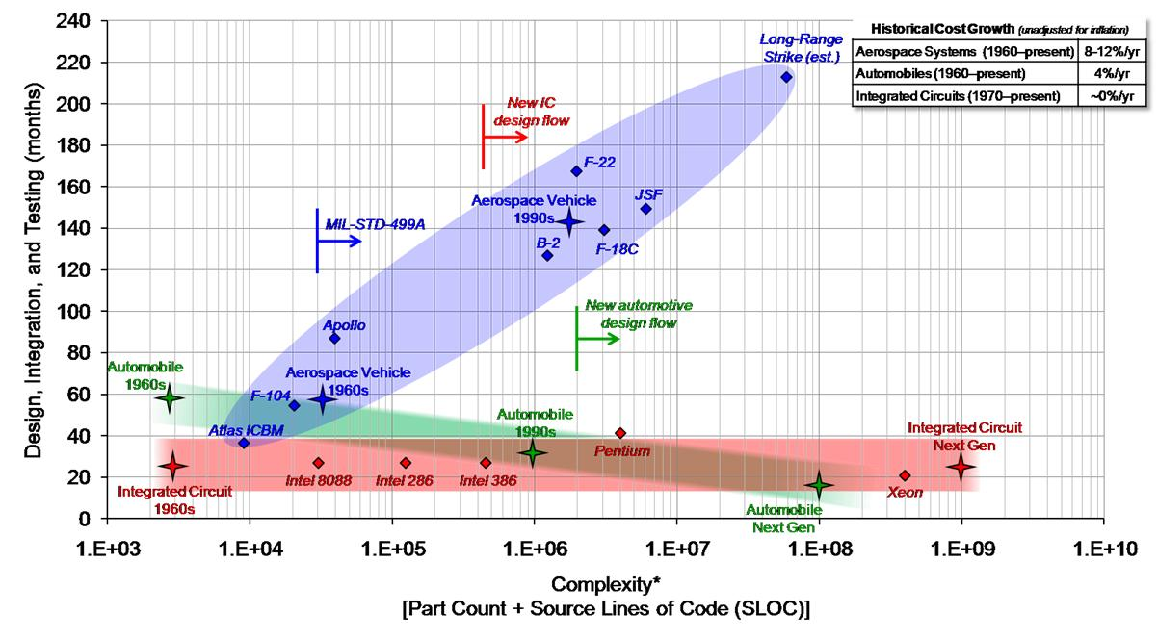
A worrisome trend

Slide 4


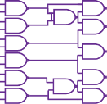

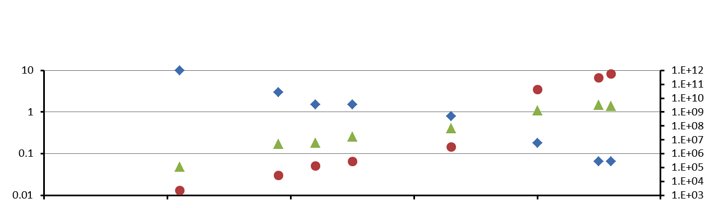


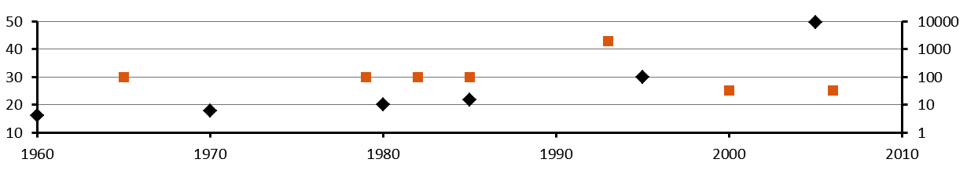
Existence proof
Transistor model
Capacity load
Gate level model
Capacity load
System-on-chip Design Framework
Wire load
IP block performance
Inter IP communication
performance models
Abstract
IP blocks
Abstract
Cluster
RTL
clusters
SW
models
increasing abstraction
RTL
Abstract
Cluster
Cluster
Feature Size (µm)
Transistors per chip
Speed (Hz)
Develop-
ment time (mo)
Daily engineer output
(Trans/day)
Sources: Singh R., Trends in VLSI Design: Methodologies and CAD Tools, CEERI,
Intel, The Evolution of a Revolution, and Sangiovanni-Vinventelli, A., Managing Complexity in IC Design, 2009

Slide 5
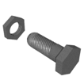
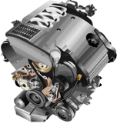
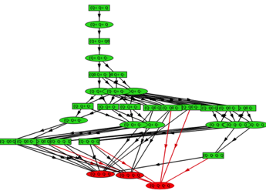
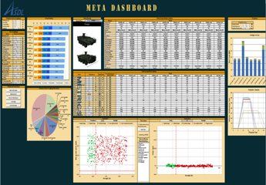

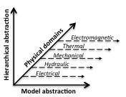
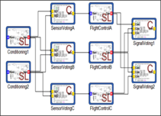
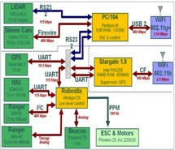
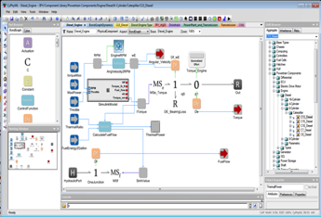
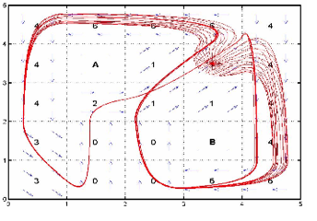
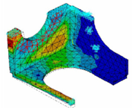
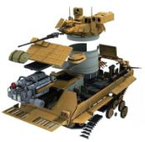
Design tools (META)
Component Models
Modelica
State Flow
Bond Graphs
AADL
Geometry
Static Trade Space Exploration
Qualitative Reasoning
Semantic
Integration
Static constraint application
Manufacturability constraints
Structural complexity metrics
Info entropy complexity metrics
Identify Pareto-dominant designs
10^10 → 10^4 designs
Qualitative abstraction of dynamics
Computationally inexpensive
Quickly eliminate undesirable designs
State space reachability analysis
10^4 → 10^3 designs
Embedded Software Synthesis
Auto code generation
Generation of hardware-
specific timing models
Monte Carlo simulation
sampling to co-verify
Hybrid model checking
under investigation
Physical
Linear Differential Equation Models
Relational Abstraction
Software
Computing
A
CAD & Partial Differential Equation Models
B
Generate composed
CAD geometry for iFAB
Generate structured &
unstructured grids
Provide constraints and
input data to PDE solvers
Couple to existing FEA, CFD,
EMI, & blast codes
10 → 1 design
Models are fully composable
Simulation trace sampling to verify
correctness probability
Application of probabilistic model
checking under investigation
10^2 → 10 designs
Relational abstraction of dynamics
Discretization of continuous state space
Enables formal model checking
State-space reachability analysis
10^3 → 10^2 designs

Slide 6
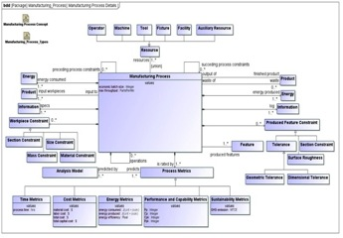
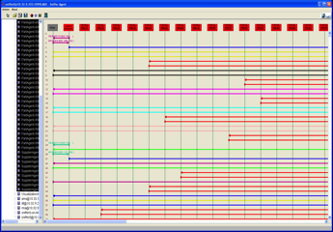
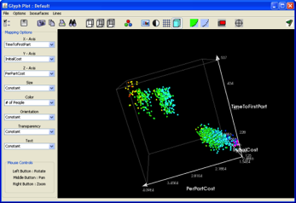
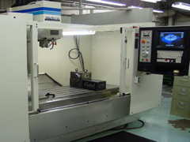
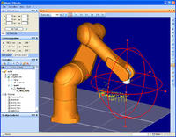
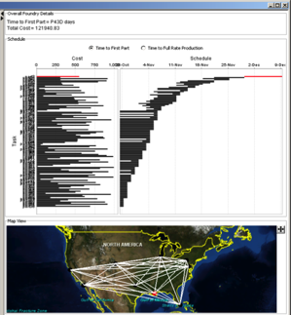
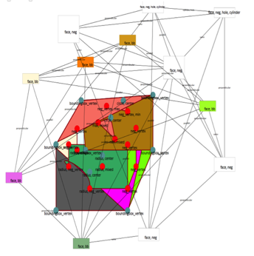
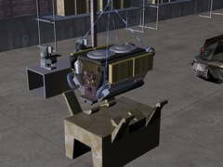
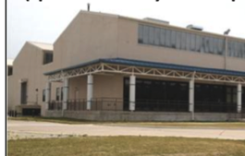
Foundry-style manufacturing tools (iFAB)
*Manufacturing Constraint
Feedback to META Design
*
Foundry Trade Space
Exploration
Static Process Mapping
Sequencing
META Design
Constraints
from Selected Configuration
Manufacturing Process Model Library
CNC Instructions
Kinematic Machine Mapping
Scheduling
Topological Decomposition
Kinematic Assembly Mapping
Human Instructions
*
Rock Island Arsenal Bldg 299 Final Assembly

Slide 7
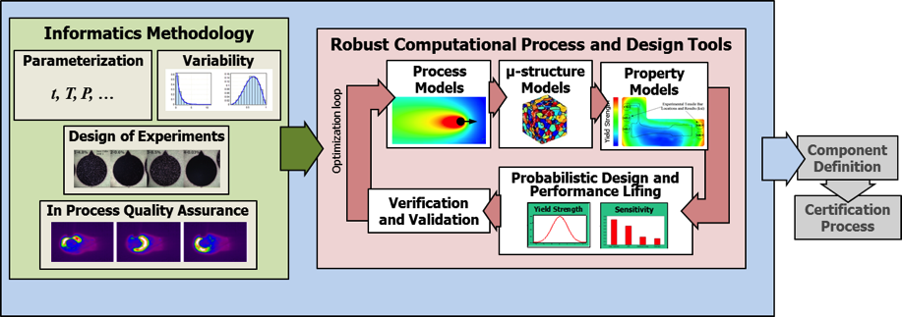
Foundry-style manufacturing processes (Open Mfr’ing)
Product Development Cycle
Manufacturing Technology Development
5-7 Years
Iterations result from uninformed manufacturing variation
Design
3-5 Years
Manufacturing variability is not captured until the sub-component/ component level testing
Test and Evaluation/Qualification/Certification
7-10 Years
Stochastic manufacturing process variation and non-uniform manufacturing process scaling drives cost and schedule uncertainty, and leads to major barriers to manufacturing technology innovation
Open Manufacturing captures factory-floor variability and integrates probabilistic computational tools, informatics systems, and rapid qualification approaches to build confidence in the process

Slide 8
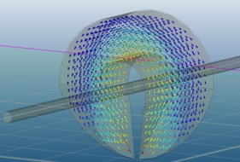
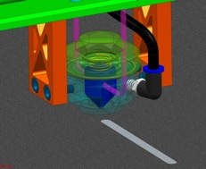
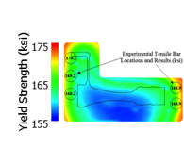


Foundry-style manufacturing processes (Open Mfr’ing)
Accelerate development of innovative additive manufacturing processes to reduce risk for first adopters
  Exemplar: Demonstration of Micro-Induction Sintering for additive manufacturing of metal matrix composites
Probabilistic computational tools (process-microstructure-property models) to predict process and part performance
  Exemplar: Integrated Computational Materials Engineering (ICME) Tools for Direct Metal Laser Sintering (DMLS) of Inconel 718
    Simulate thermal history of the laser sintered powder, residual stress of the sintered material, gamma prime phase particle size distribution, and material performance
Flux
Concentrator
Consolidated
metal matrix composite
Powder bed
Process
Models
μ-structural
Models
Property
Models

Slide 9
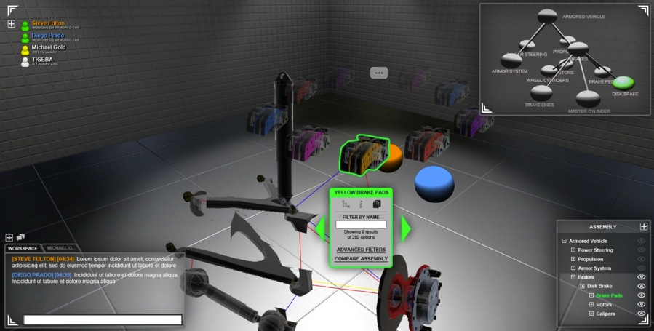
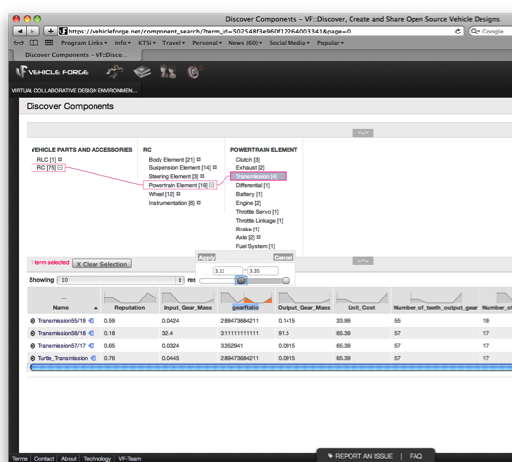
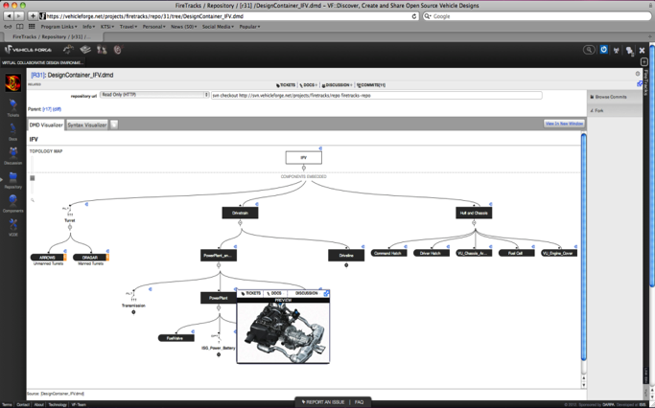
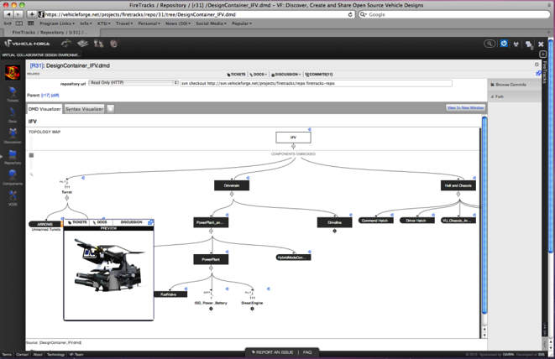
Open innovation (VehicleFORGE)

Slide 10
Adaptive Make for Synthetic Biology

Slide 11
A worrisome trend
10¹¹
minimal bacterium
yeast
10¹⁰
DARPA annual budget
 | SOA | Goal
Design | 1-3 months | <1 week
DNA Synth. | $0.45-$0.75 2wks-2mos 20 kb | $0.004 2 days Mb’s
Test/Debug | weeks | <1 day
Complexity | <10s genes routine: <10 | 10³-10⁴ genes
Total Time | 7 yrs | <1 yr
10⁹
10⁸
Effort (total $ * yrs to develop) [$*yr]
10⁷
10⁶
LF: after 6 mos
Living Foundries
10⁵
10⁴
metabolic engineering
complex genetic circuits
genome rewrite
10³
1 10 100 1,000 10,000 100,000
Complexity (# genes inserted/modified)
Notes:
Several recent bio-products that have come out onto the market.
Dupont: 12 yrs-400 M (Note that while cost and time was large, completely worth it for dupont. Now completely own the 1,3 propanediol market, which was once an expensive, inefficiency, low yield product to produce, and have taken over new markets.
Artemisinin--$25M 8 yrs
GEVO--$100M, 8yrs
The unique properties and attributes of 1,3 propanediol based polymers been known for many years. 3GT fibers were reported to have better elastic recovery and lower modulus versus PET and PBT [1]. Until recently, three factors have effectively kept 3GT polymer off the market: the relatively high cost of the
1,3-propanediol; inability to make high quality polymer for downstream end-uses; and more difficult polymer process requirements compared to 2GT.
The fiber is highly resistant to most stains without the need for surface treatment with additives or coatings. It resists UV degradation better than other fibers, and exhibits both low water absorption and low electrostatic charging
Small increases in complecity lead to rapid increases in both time and $$
Sets up an artificial complecity barrier—largely still limited to metabolic engineering
Limits the number of new entrants into the market. Few can afford the expertise, time and capital to develop a new product—limit on innovation
We’re not improving with time. Each one of the projects is largely a one off.
The goal of living foundries is to break this current paradigm and enabling us to explore the full complexity space and ultimately bringing down the cost and time necesssary to do so.
2 major goals of living foundries: speed the biological design-build-test cycle (the process of taking a new biological design from conception to execution. Expand the complexity of systems that can designed and engineered.
Slide 3 was what’s possible with engineering biology
Slide 4/5 is the revolution occurring with all this new speed to do synthesis and sequencing and more people.
BUT
Slide 6 tells us that even with all this potential and growing ability, we’re still suck here in this blue part . . But we need to be over in the green part.
Next slide identifies what the problem is. . .
Then we talk about how the same thing happened with ICs, and VLSI saved the day.
So our program is going to be about bringing engineering to biology in a tangible fashion.

Slide 12
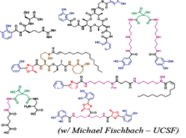
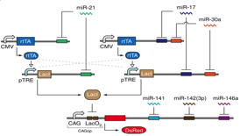

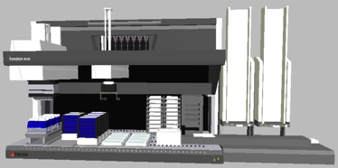
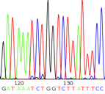
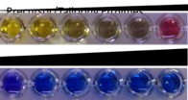
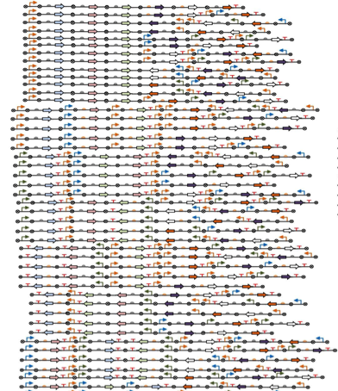
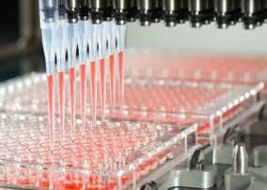
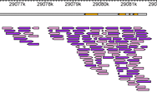
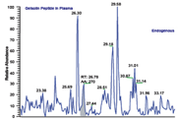
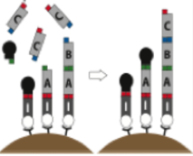
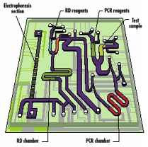
Design tools (Living Foundries)
New molecules/new functions
Computer Aided Design
Learn
Data Management
JIRA Bug Tracking
Sequencing
Activity
Transcript Levels
Test
Protein Levels
Design
Build
High-Throughput Screening:
Sequencing, RNA-seq, Mass spec, Multiplex PCR, LC-MS, GC-MS
Synthesis/Assembly/Strain Creation: Molecular Biology, Microfluidics and Liquid Handling
12
Notes:
Computer aided design as the core link between synthetic biology design tools and synthesis/verification/debugging LabOS pipelines. The designer needs to manage information from multiple sources that inform the design tools. This includes the ability, for example, to integrate JIRA bug tracking with screening data. It also requires the integration of data from diverse sources, including sequencing, proteomics, and transcriptomics to better inform design choices.

Slide 13
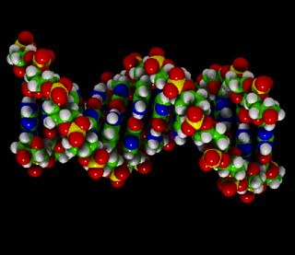
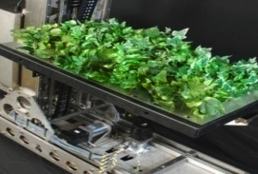
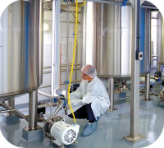
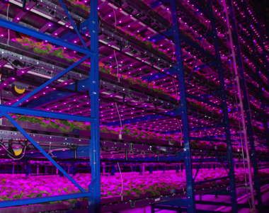
Foundry-style manufacturing (Blue Angel)
  The result today…
  Rapid, adaptive platform. Tobacco plant production may result in more rapid production cycles (< 30 days) and less facility expenditures to increase capacity once an FDA approved product is available.
  Biology provides the
  design rules and models
  Vaccine implementation:
  Only the relevant genetic sequence of bug required, not entire virus.
  The tobacco plant is the ‘protein foundry.’
  Vaccine implementation: Redirection of tobacco plant protein production results in candidate protein synthesis.
Texas A&M University (TAMU)-Caliber example:
Growth room is approximately the size of
half a football field at four stories tall
(150 feet x 100 feet x 50 feet high)
Total number of plants: 2.2 million
DARPA Blue Angel program enabled…
A 4 site manufacturing platform in the USA capable of meeting phase 1 appropriate FDA requirements for vaccine production.
3 Investigational New Drug Applications with the FDA
3 Phase 1 clinical trials

Slide 14
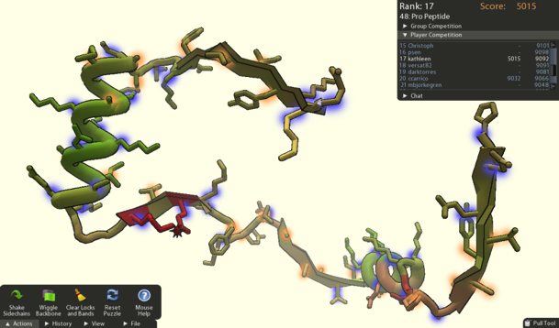
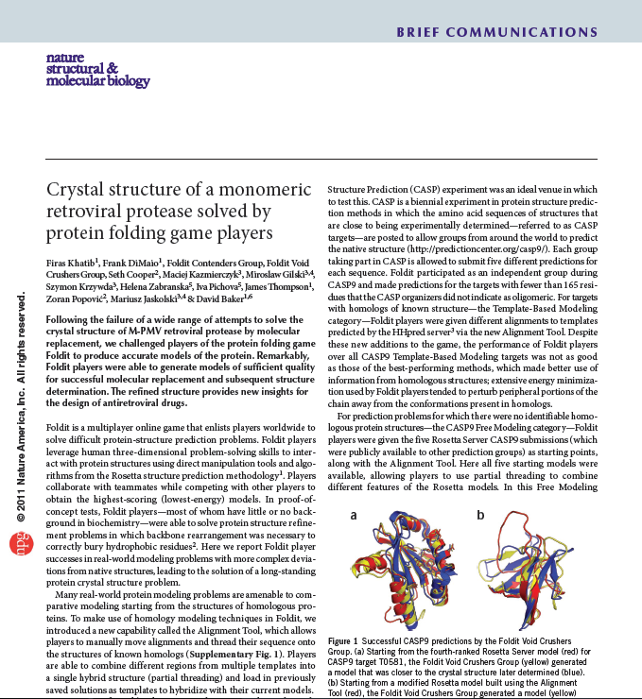
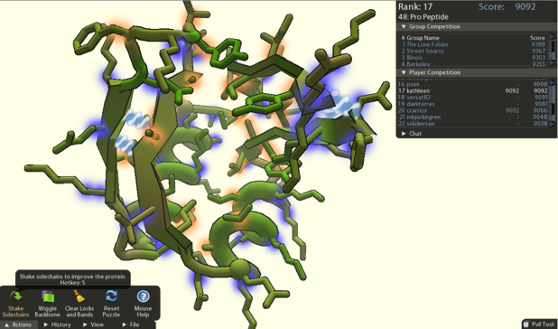
Open innovation (FoldIt)
Unfolded (unstable)
Folded (stable)
Sources: Fold it, Katib et al,
Crystal structure of a monomeric retroviral protease solved by protein folding game players., Nature Structural and Molecular Biology 18, 1175–1177, 2011

Slide 15
Adaptive Make for Robotics

Slide 16


Design tools (M3)
Analogy: Hierarchical Electronic Design Automation (EDA) has catalyzed circuit design, enabling exploitation of Moore’s law
Robot Design, presently ad-hoc, desperately needs analogous tools, even though the problem is harder:
  Hierarchical “simulator in the loop”, near-real-time design tools, allowing bi-directional interaction with designers
  Designer-guided interactive optimization + design space exploration (e.g. GA)
  Statistically valid, hierarchical environment and contact models
  Statistically valid, hierarchical human operator + adversary models
We can significantly amplify DARPA’s investment in robotics design tools through open source partnering with researchers and enthusiasts worldwide
  Our adversaries largely don’t need robots - improvements in robotics catalyzed by DARPA will largely benefit the US even if improvements are shared globally
Notes:
Graphic on the left shows a model of Rhex (a hexapod robot known for wild-looking movement) and a model of rocks secured to the ground.
Graphic in the middle shows the paths (red lines) that the real Rhex took when walking over the real rocks. Lots of different paths, lots of scatter, it rarely followed the same path twice.
Graphic on the right shows the results of predicting the end position of Rhex for different starting positions. The results show that the predictions are not very good.
All together, the story that the graphics tell is that if we had good models of the contact between the legs and the ground then we could simulate travel of the robot over different terrains, and we could use that as a design tool to create robots that successfully handled the terrain.

Slide 17




Fabrication (M3)
Serial Processes
Printing Processes
Self Assembly
Manual Assembly
Present Rapid Prototyping
Roll-Roll Printing
Plate Printing
Nature
Tissue Engineering
(e.g. insect muscles)
Ward, Pratt, et. al (1992)
Neal Gershenfeld, MIT
(DSO Prog. Matter)
Ron Fearing, UCB
Notes:
The log-log plot has time on the y axis and N the number of components on the x axis. Standard serial processes have a slope of 1 in this plot; this is the state of the art. Printing processes have slopes of 2/3 or 1/3 in this plot. Self-assembly processes have slopes of 1/3 and less.
The two graphics on the lower left show pieces of printed cardboard (left-hand side) that are folded and assembled by Ron Fearing Lab at Berkeley to create a hexapod robot (right-hand side). This is an example of the printing process reducing the time complexity of fabrication to something like the square root of N where N is the number of components.
The graphics on the right show examples of various self-assembled structures.

Slide 18


Open innovation (DARPA Robotics Challenge)

Slide 20
Backup/Reference Charts

Slide 21
Status quo approach for managing complexity

Slide 22


Little change in the systems engineering process
Engineering Change Requests (ECRs) per Month of Program Life
Mariner Spacecraft (1960s)
Modern Cyber-Electromechanical System (2000s)
From Project Inception through Midcourse Maneuver, vol. 1 of Mariner Mars 1964 Project Report: Mission and Spacecraft Development, Technical Report No. 32-740, 1 March 1965, JPLA 8-28, p. 32, fig. 20.
Giffin M., de Weck O., et al., Change Propagation Analysis in Complex Technical Systems, J. Mech. Design, 131 (8), Aug. 2009.
Notes:
It was recognized from the outset that DARPA’s unique mission required an organization with unique characteristics. Among the most salient of these are:
It is independent from service R&D organizations. DARPA neither supports a service directly nor does it seek to implement solutions to identified service requirements. Its purpose is to focus on capabilities that have not been identified in service R&D and on meeting defense needs that are not defined explicitly as service requirements.
It is a lean, agile organization with a risk-taking culture. DARPA’s charter to focus on “high-risk – high-payoff” research requires that it be tolerant of failure and open to learning. It has had to learn to manage risk, not avoid it. Because of its charter, it has adopted organizational, management, and personnel policies that encourage individual responsibility and initiative, and a high degree of flexibility in program definition. This is one reason that DARPA does not maintain any of its own labs.
A primary aspect of DARPA’s lean structure is that it centers on and facilitates the initiative of its program managers. The DARPA program manager is the technical champion who conceives and owns the program. As the program manager is the guiding intelligence behind the program, the most important decisions of DARPA’s few office directors are the selection of and support of risk-taking, idea-driven program managers dedicated to making the technology work.
It is idea-driven and outcome-oriented. The coin of the realm at DARPA is promising ideas. The program manager succeeds by convincing others – the office director and the DARPA director – that he or she has identified a high potential new concept. The gating notion isn’t that the idea is well-proven, but that it has high prospects of making a difference. The DARPA program manager will seek out and fund researchers within U.S. defense contractors, private companies, and universities to bring the incipient concept into fruition. Thus, the research is outcome-driven to achieve results toward identified goals, not to pursue science per se. The goals may vary from demonstrating that an idea is technically feasible to providing proof-of-concept for an operational capability. To achieve these results the program manager needs to be open to competing approaches, and be adroit and tough-minded in selecting among these.
http://www.darpa.mil/Docs/Intro_-_Van_Atta_200807180920581.pdf

Slide 23

Complexity is the root cause of cost growth
Notes:
It was recognized from the outset that DARPA’s unique mission required an organization with unique characteristics. Among the most salient of these are:
It is independent from service R&D organizations. DARPA neither supports a service directly nor does it seek to implement solutions to identified service requirements. Its purpose is to focus on capabilities that have not been identified in service R&D and on meeting defense needs that are not defined explicitly as service requirements.
It is a lean, agile organization with a risk-taking culture. DARPA’s charter to focus on “high-risk – high-payoff” research requires that it be tolerant of failure and open to learning. It has had to learn to manage risk, not avoid it. Because of its charter, it has adopted organizational, management, and personnel policies that encourage individual responsibility and initiative, and a high degree of flexibility in program definition. This is one reason that DARPA does not maintain any of its own labs.
A primary aspect of DARPA’s lean structure is that it centers on and facilitates the initiative of its program managers. The DARPA program manager is the technical champion who conceives and owns the program. As the program manager is the guiding intelligence behind the program, the most important decisions of DARPA’s few office directors are the selection of and support of risk-taking, idea-driven program managers dedicated to making the technology work.
It is idea-driven and outcome-oriented. The coin of the realm at DARPA is promising ideas. The program manager succeeds by convincing others – the office director and the DARPA director – that he or she has identified a high potential new concept. The gating notion isn’t that the idea is well-proven, but that it has high prospects of making a difference. The DARPA program manager will seek out and fund researchers within U.S. defense contractors, private companies, and universities to bring the incipient concept into fruition. Thus, the research is outcome-driven to achieve results toward identified goals, not to pursue science per se. The goals may vary from demonstrating that an idea is technically feasible to providing proof-of-concept for an operational capability. To achieve these results the program manager needs to be open to competing approaches, and be adroit and tough-minded in selecting among these.
http://www.darpa.mil/Docs/Intro_-_Van_Atta_200807180920581.pdf

Slide 24

AVM integrated toolchain with major releases
Design Trade Space Visualization
Dynamic Visualization
Constraints from Higher Levels of Abstraction
Legend:
Structural & Entropy-Based Complexity Metrics Calculation
FANG1
Component Model Library
Domain-
Specific
Modeling
Languages
Semantic Integration
FANG2
Design Space Construction(Static Models)
Qualitative/ Relational
Models
Linear Differential Equation
Models
Nonlinear Differential Equation (PDE)
Models
FANG2’
FANG3
Static Constraint Solver
Reachability Analysis
Controller/
FDIR Synthesis
CAD Geometry/ Grid Synthesis
Context Model
Library
Multi-
Attribute
Preference
Surfaces
User Req’t Synthesis
Probabilistic Model Checker
Monte Carlo Dynamic Sim
FEA
CFD
Manufacturability
Constraints
Requirements
Verification
Probabilistic Certificate of Correctness
BOM
. . .
Visualization
Foundry Trade Space Construct.
Ass’y Selection
Process Mapping
Design Update
Feedback
PLM
Metrics
Machine Selection
QA/QC
Foundry Resource
Scheduler
Machine/Ass’y Mod Lib
Process Model Library
Instruction Sets
CNC Generator

Slide 25



AVM component model
Parameter/property
interfaces
Low-fidelity dynamics
Power
interfaces
Signal
interfaces
Structural
interfaces
Structural
interfaces
Detailed geometry
FEA geometry
25

Slide 26
Integration of formal semantics across multiple domains
Composition
Continuous Time
Discrete Time
Discrete Event
Energy flows
Signal flows
Geometric
META Semantic Integration
Simulink/
Stateflow
Embedded Software Modeling
Hybrid Bond Graph
Modelica
TrueTime
Functional Mock-up
Unit
Equations
Modelica-XML
FMU-ME
S-function
FMU-CS
High Level
Architecture
Interface (HLA)
Formal Verification
Qualitative reasoning
Relational abstraction
Model checking
Bounded model checking
Stochastic Co-Simulation
Open Modelica
Delta Theta
Dymola
Distributed Simulation
NS3
OMNET
Delta-3D
CPN

