Slide 1
Learning the Rules of Genome Design John Glass for members of the Venter Institute Synthetic Genomics Group The J. Craig Venter Institute, Rockville, MD and San Diego, CA
Notes:
At the 2005 ASM General Meeting in Salt Lake City I was one of the speakers at the division G symposium. I was substituting for my friend Scott Peterson who was on his honeymoon that week. At the time I was a scientist at the pharmaceutical company Eli Lilly, and my career emphasis was turning away from bacteriology and towards virology. I thought my ASM talk would be a sort of punctuation mark on my mycoplasmology career. I concluded my talk on mycoplasma genomics with this statement which I transcribed from the audio tape provided to me by ASM by saying that “some time soon, Craig Venter’s team, or someone with similar skills and interests, will stitch together a huge series of oligonucleotides to make the synthetic chromosome of a minimal cell, and then enliven that Mycoplasma laboratorium genome by transplanting it into some kind of ghost cell.” Prophecy? Irony? Déjà vu? All of the above to say the least…
So here we are 5 years later, and I stand before you to offer a progress report on what is the most remarkable science I have ever heard of, much less been a part of. We are going to create a living bacterial cell from off the shelf chemicals. We will then iteratively recreate that cell, which will be based on Mycoplasma genitalium, in simpler and simpler forms by building genomes with ever fewer genes until we arrive at the essence of what is a living cell. That cell, that Mycoplasma laboratorium as I mused before this group 5 years ago, will be the platform for achieving a real complete understanding of what cellular life really is.
Ever since the 1930’s when a hand full of physicists, chemists, and biologists banded together into the Phage School led by Max Delbruck, there have been efforts to understand life at its simplest and most fundamental level. In the ensuing decades up to the present, we have achieved a complete understanding of the genetic and chemical structure of a number of viruses and know in many cases the role of all of their genes. The same cannot be said for cells. The simplest cells are bacteria, but they generally contain thousands of genes. In 1995 the first complete sequence of a bacterial cell was determined. Since then hundreds of bacteria, archaea, and eucaryotes have been sequenced. It is now possible to ask the fundamental questions, “How many genes does a cell need?” To what extent can one reduce the size of a cell’s genome by consecutive deletions and still have a viable cell? What is the minimal set of genes or functions necessary to sustain the cell under ideal laboratory conditions? These are the fundamental questions that my colleagues and I at the J. Craig Venter Institute are now pursuing.

Slide 2
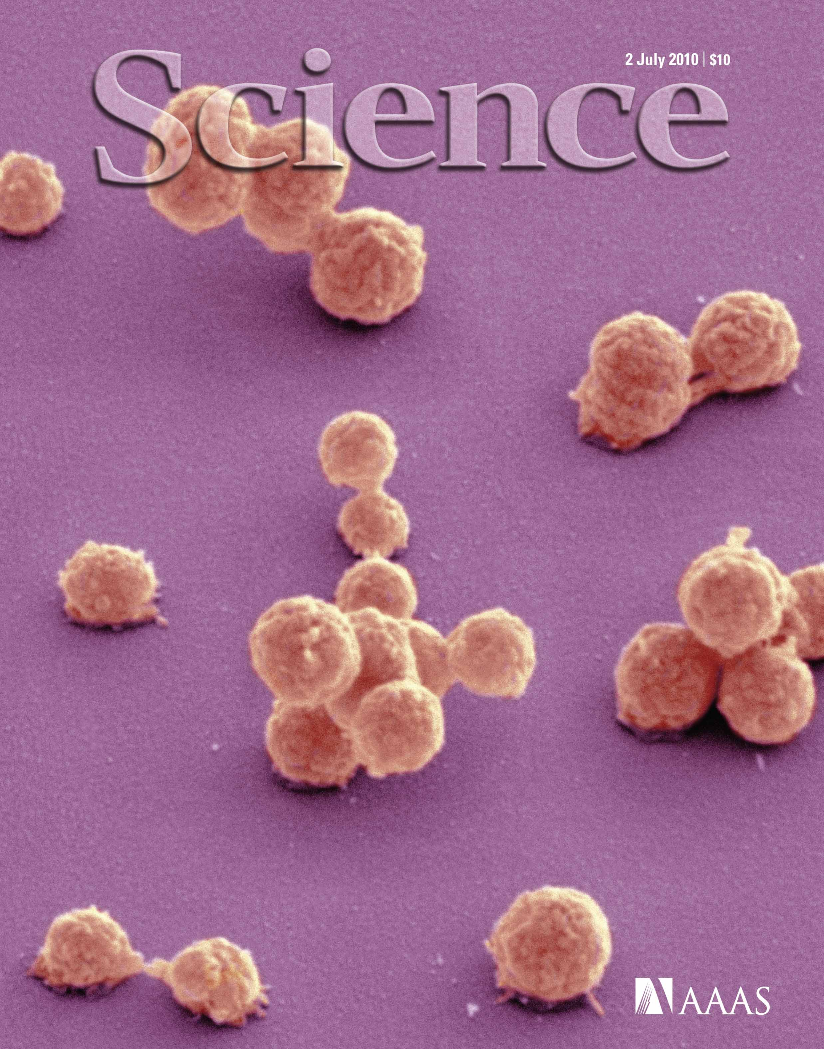

Slide 3
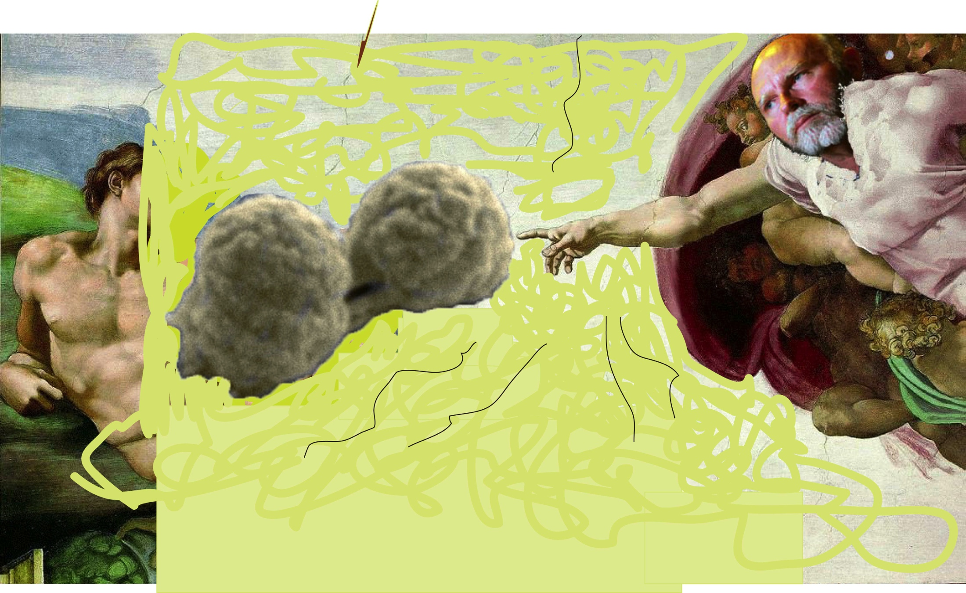
Construction of a Bacterial Cell Containing Only Essential Genes Necessary to Impart Life
Ham Smith, Dan Gibson, John Glass, and the JCVI Synthetic Biology Group
DARPA Contract # HR0011-12-C-0063
Rockville, MD and San Diego, CA,USA

Slide 4
Why are we building a minimal cell?
To discover the genetic kernel of life
To provide a platform for systems biologists
To learn essential design features for genomes
To modularize genomes for easier design
Reduced, Reorganized
Biosynthesis of cofactors, prosthetic groups, and carriers
Cell envelope
Cellular processes
Central intermediary metabolism
DNA metabolism
Energy metabolism
Fatty acid and phospholipid metabolism
Hypothetical proteins
Noncoding RNA feature
Protein fate
Protein synthesis
Purines, pyrimidines, nucleosides, and nucleotides
Regulatory functions
Signal transduction
Transcription
Transport and binding proteins
Unclassified
Unknown function

Slide 5
Number of genes in each class
in
58
i
127
n
438
ie 48
e
241

Slide 6
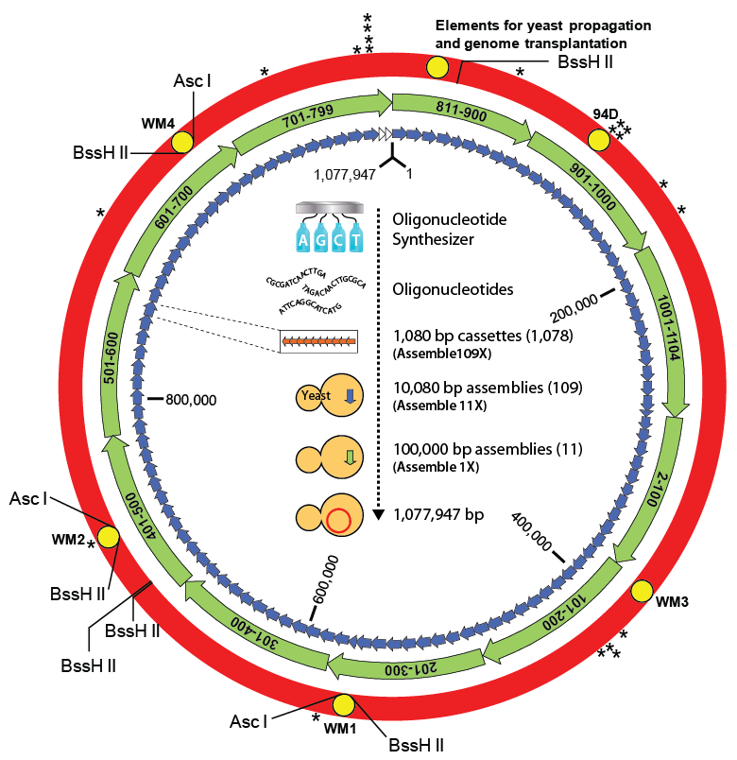
Synthesis of a Reduced Genome Design

Slide 7
Construction of 1/8 RGD + 7/8 wild type genome by Recombinase-Mediated Cassette Exchange (RMCE).
Syn1 Genome
2
3’ URA3
MET14
RMCE
5' URA3
1/8 HMG
1
1/8th RGD Donor Plasmid
3’ URA3
MET14
Prom
Cre recombinase
Landing pad
3
5' URA3
3’ URA3
MET14
+
Prom
Cre recombinase
Notes:
Construction of the 1/8 RGD +7/8 wild-type genome by Recombinase-mediated cassette exchange (RMCE). 1) A 1/8 genome of the M. mycoides JCVI-syn1.0 was replaced with a cassette called landing pad flanked by two hetero-specific lox sites; 2) A donor plasmid containing a corresponding 1/8 RGD, flanked by another two hetero-specific lox sites, was introduced into to the landing pad strain; and 3) The 1/8 RGD was swapped into the landing pad locus via the Cre-mediated recombination. An intron-containing URA3 gene was split into the landing pad and the donor plasmid so that the cassette exchange can be selected by restoration of uracil prototrophy

Slide 8
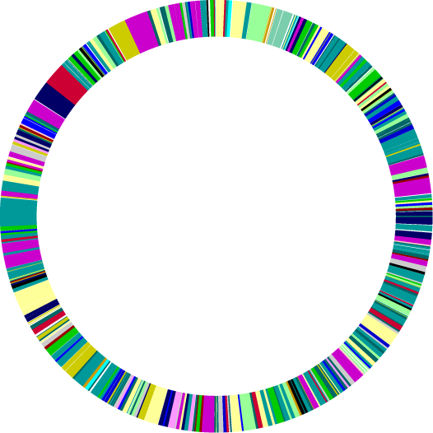
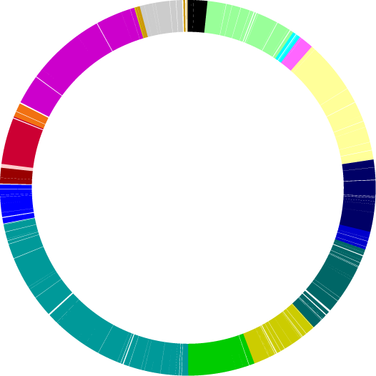
Modularization (defragmentation)
Before
After
Biosynthesis of cofactors & prosthetic groups
Cell envelope
Cellular processes
Central intermediary metabolism
DNA metabolism
Energy metabolism
Fatty acid and phospholipid metabolism
Hypothetical proteins
Noncoding RNA feature
Protein fate
Protein synthesis
Purines, pyrimidines, nuc’sides & nuc’tides
Regulatory functions
Signal transduction
Transcription
Transport and binding proteins
Unclassified
Unknown function
Notes:
Mention tRNA clustering

Slide 9
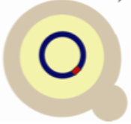
3 Technologies Invented to Produce Synthetic Bacterial Cells
Assemble overlapping synthetic oligonucleotides (~60 mers)
Recipient cell
Synthetic cell
Cassettes (5-7 kb)
Assemble cassettes by homologous recombination
Genome
Transplantation
Completely assembled synthetic genome
Yeast Clone
Genome Synthesis

Slide 10
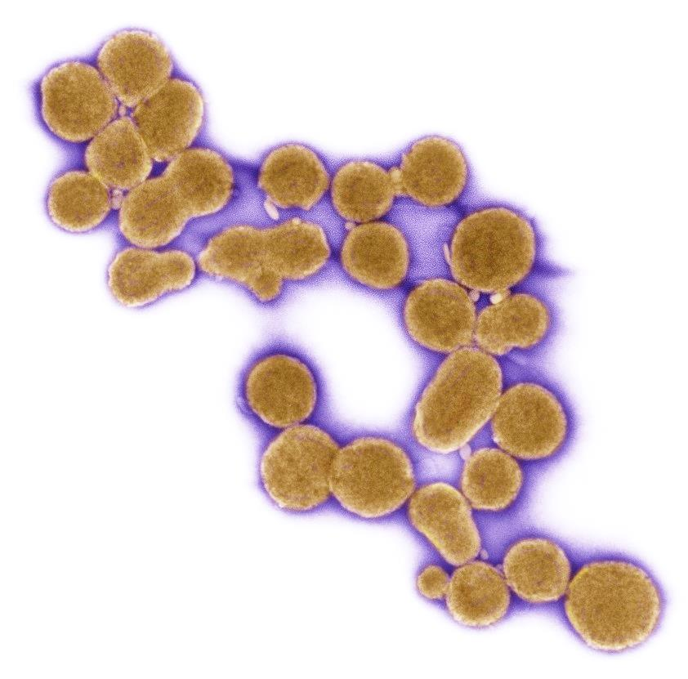
It Takes a Village to Create a Cell
JCVI
Assad-Garcia, Nacyra
Chuang, Ray-Yuan
Gibson, Daniel
Glass, John
Hutchison, Clyde
Karas, Bogumil
Ma, Li
Merryman, Chuck
Montague, Michael
Noskov, Vladimir
Smith, Ham
Sun, Lijie
Suzuki, Yo
Venter, Craig
Wise , Kim
Yee, Tony
Synthetic Genomics, Inc.
Gibson, Dan
Support from DARPA Living Foundries
Synthetic Genomics, Inc.
Venter, Craig

Slide 11
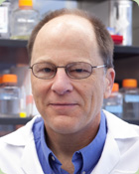
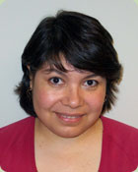
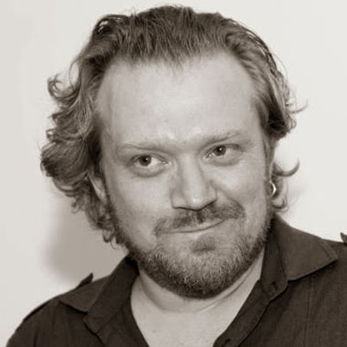
Microfluidics for genome transplantation
James Pelletier, Elizabeth Strychalski, Nacyra Assad-Garcia, Vanya Paralanov, Andreas Mershin, Neil Gershenfeld, John Glass
Notes:
This is a collaboration between John Glass, Nacyra Assad-Garcia, and Vanya Paralanov of the JCVI; Elizabeth Strychalski of NIST; and Andreas Mershin, Neil Gershenfeld, and myself of the MIT CBA.

Slide 12
How can we transfer megabases of DNA into bacteria?
Whole genomes are as big as cells!
recipient cells
Mycoplasma capricolum
5 µm
donor genomes
Mycoplasma mycoides
5 µm
Lartigue et al. Science 2009
Notes:
To achieve this goal, the JCVI has developed a workflow that involves bacterial chromosomes as yeast centromeric plasmids (YCPs). We use the genetically tractable organism to manipulate the genetically intractable bacteria. Yeast and bacteria do not share regulatory sequences, so the entire genome lives in yeast as an inert piece of DNA; compared to bacterial host model organisms, toxicity is less problematic.

Slide 13
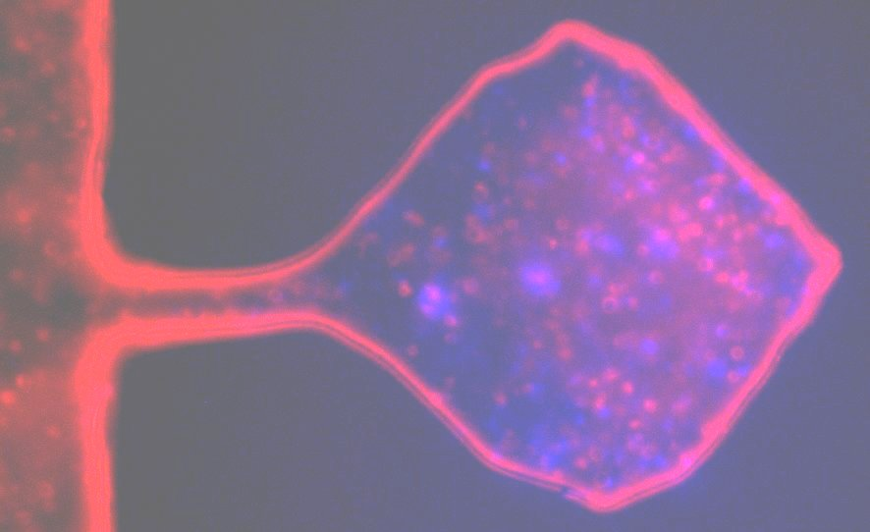
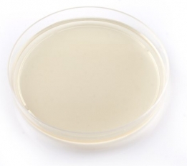
Microfluidics for genome transplantation
bulk
microfluidic
precise
gentle
control
isolate donor DNA
high cell/DNA densities
mix donor genomes
and recipient cells
reveal mechanism
recover cells
10 µm
http://www.partnaranimalhealth.com/osCommerce/images/DCE-0016S%20Centrifuge%20Tube.jpg
http://ecx.images-amazon.com/images/I/215d1cMFryL._SX342_.jpg
http://www.avena-medica.com/ProductVault/product_1351077166__mg_3651_S4.jpg
Notes:
To achieve this goal, the JCVI has developed a workflow that involves bacterial chromosomes as yeast centromeric plasmids (YCPs). We use the genetically tractable organism to manipulate the genetically intractable bacteria. Yeast and bacteria do not share regulatory sequences, so the entire genome lives in yeast as an inert piece of DNA; compared to bacterial host model organisms, toxicity is less problematic. advantages
precise control
real-time visualization
high cell/genome densities
genomes not damaged..
big disadvantage
low throughput

Slide 15
step 3: condense donor genomes and cluster recipient cells
10 µm

Slide 16
step 4: compress genomes and cells
2 µm
10 µm

Slide 17
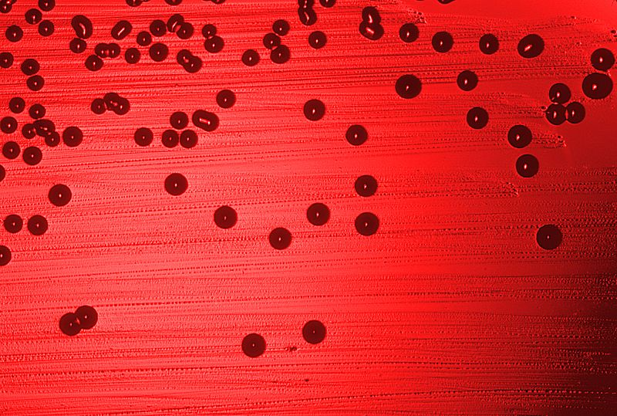
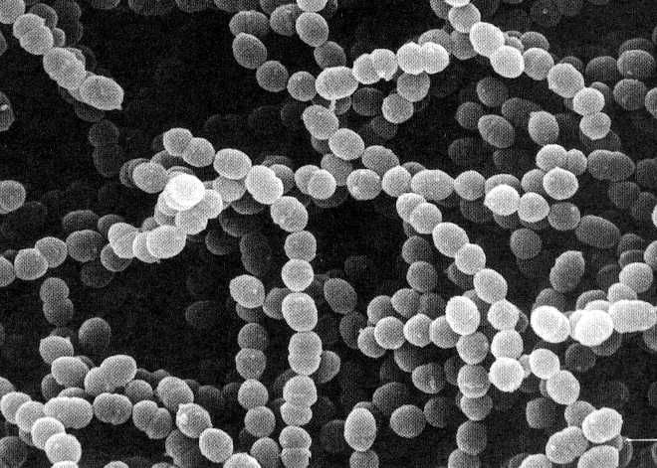
Microfluidics to complement genome transplantation
precise, gentle control
real-time visualization
high cell/genome densities
multi-parameter optimizations
Gram-negative
H. influenzae
Gram-positive
S. thermophilus
yeast nuclei
next steps
Notes:
Genome transplantation, generalized to other bacterial species, will be a powerful tool in the synthetic biology toolbox. The ability to transfer megabases of DNA to bacteria would dramatically accelerate synthetic biology research, so we must attack this problem from every possible angle. We have learned from the mycoides/capricolum system that a few degrees or a few minutes can make a huge difference, and each bacterial species will require its own optimization, when we attempt this in model gram-negative and gram-positive bacteria, such as the H influenzae and S thermophilus we will try next. We feel the array of micro/nanofluidics tools. To guide us to find parameters that work in bulk, or to achieve conditions we cannot achieve in bulk. this will help us control, optimize, understand genome transplantation.. so groups around the world take that info and use to increase the throughput of either bulk or microfluidic experiments.

Slide 18
Thank you very much!
John Glass
Nacyra-Assad Garcia
Vanya Paralanov
Evgeniya Denisova
David Brown
Adriana Jiga
Elizabeth Strychalski
Jason Kralj
Javier Atencia
Andreas Mershin
Neil Gershenfeld
Will Langford
Prashant Patil
Charles Fracchia
Fei Chen
Paul Tillberg
David Feldman
You!

